Slide 1
Controversial Freedoms
An Unconventional, Provocative Look at Freedom
Notes:
Civil liberties are our fundamental freedoms. We talk a lot about freedom in America and about how much we support freedom and advocate it for the rest of the world, but I don’t think people support freedom as much as they think they do, especially when freedom is most controversial. Consider the following examples of freedom:
Here are some freedoms many conservatives in America would object to:
Freedom is “offensive,” e.g., burning the American flag is very offensive to many Americans. Burning the Qu’ran (or the Bible) is very offensive to Muslims (Christians), yet these are freedoms in a free society
Freedom is “immoral,” e.g., smoking marijuana is bad for one’s health (in most cases), causing one to have slower mental faculties, yet marijuana smoking is becoming a freedom
Freedom is “irreligious,” e.g., same-sex relations are irreligious; homosexuals are to be executed in the Old Testaments (though Christians tend to reject the harsh punishments of the Old Testament), yet gay marriage is spreading across America and throughout the world as fundamental right of freedom
Here are some freedoms many liberals in America would object to:
Freedom is potentially “dangerous,” e.g., a lot of irresponsible people own guns and potentially could do a lot of harm with these weapons, yet the right to self-defense and thus the right to won a gun is a fundamental right in a free society
Freedom is “excessive,” e.g., Exxon/Mobile makes has about $400 billion in revenue per year, and in 2012, Exxon/Mobile made about $44 billion in profit, yet making enormous amounts of profit (money) is permissible in a free society
Freedom is “racist,” e.g., in a perfectly free society, which does not exist in America, a business owner would be able to serve who he or she wants, thus he or she would have the right to refuse service to blacks, Muslims, gays, etc.
Because of our terrible history on race (slavery, segregation, racism), we made it illegal to discriminate against blacks 50 years ago and have slowly expanded those civil rights protections to more demographics, such as women. Today, cities and states are passing laws to protect gays from discrimination. Still, in a perfectly free society, business owners would be able to discriminate and the way we would combat that behavior would be through protests and boycotts of the business.
I don’t think a whole lot of people in America support these types of controversial freedoms, which is why there are so many supporters of authoritarian values here…and elsewhere in the world.

Slide 2
Lecture Outline
Freedom House (An International Perspective)
Freedom in the World
Press Freedom
Freedom Under Attack
North Korean Cyber Attack on Sony Pictures (2014)
(Al Qa’ida in Yemen) Terrorist Attack on Charlie Hebdo (2015)
Saudi Arabia Murder of Jamal Khashoggi (2018)
Houston Rockets Tweet of Support for Hong Kong (2019)
Silencing Offensive Free Speech in America (2020)
Controversial Freedoms Many Conservatives Would Find Objectionable
Burning the American flag, the Bible, the Qu’ran
Marijuana use
Same-sex relations (homosexuality)
Controversial Freedoms Many Liberals Would Find Objectionable
Gun ownership
Excessive profits
Discriminatory Business Practices
Offensive Free Speech

Slide 3
Controversial Freedoms The Basics
Freedom v. Authoritarianism: Freedom is controversial everywhere, even in America where we claim that we stand for “freedom”
The bigger picture is ideological
For instance, what is the best way to organize a society, under a free government or under an authoritarian government?
The world is divided on this issue
Much of the conflict in the world is caused by this ideological conflict: freedom v. authoritarianism
There are a variety of types of authoritarian governments in the world:
China – officially a communist government but economic freedom is being allowed in the business world
Russia – officially a democracy, but in reality power is concentrated in the president (Vladimir Putin)
Iran – officially a theocracy (religious government), though Iran has a thriving democratic element, the religious side of government can veto anything passed by civilian (democratic) side of government
Saudi Arabia – officially a monarchy though there is a sharing of power between the religious side of government and the monarchy (i.e., 6000 members of the royal family)

Slide 4
Freedom House
An International Perspective

Slide 5
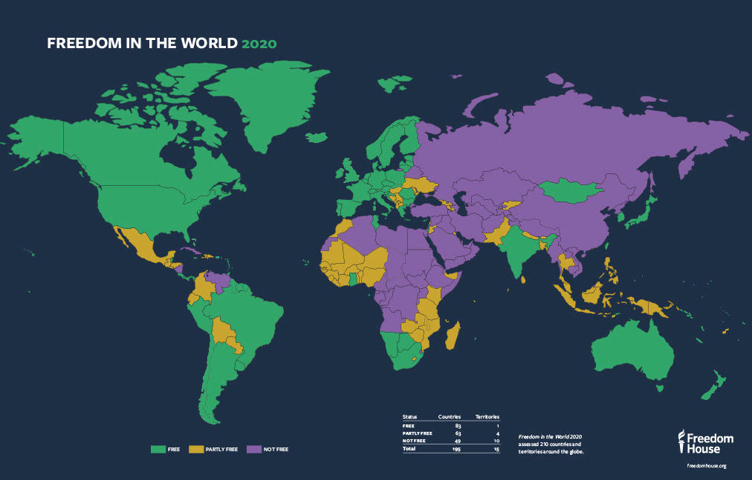
Freedom House Freedom in the World (2019)
Freedom House evaluates ~200 countries, classifying them as free, partly free, and not free, based on how well the government protects political rights and civil liberties
Notes:
FIW_2020_Map_JPG_RGB.jpg (1024×663) (freedomhouse.org)
Freedom in the World 2020: A Leaderless Struggle for Democracy (freedomhouse.org)
https://www.freedomhouse.org/report/freedom-world-2015/methodology#.VUR-MvCYGoZ
Ratings and Status Characteristics
Political Rights
1 – Countries and territories with a rating of 1 enjoy a wide range of political rights, including free and fair elections. Candidates who are elected actually rule, political parties are competitive, the opposition plays an important role and enjoys real power, and the interests of minority groups are well represented in politics and government.
2 – Countries and territories with a rating of 2 have slightly weaker political rights than those with a rating of 1 because of such factors as political corruption, limits on the functioning of political parties and opposition groups, and foreign or military influence on politics.
3, 4, 5 – Countries and territories with a rating of 3, 4, or 5 either moderately protect almost all political rights or strongly protect some political rights while neglecting others. The same factors that undermine freedom in countries with a rating of 2 may also weaken political rights in those with a rating of 3, 4, or 5, but to a greater extent at each successive rating.
6 – Countries and territories with a rating of 6 have very restricted political rights. They are ruled by one-party or military dictatorships, religious hierarchies, or autocrats. They may allow a few political rights, such as some representation or autonomy for minority groups, and a few are traditional monarchies that tolerate political discussion and accept public petitions.
7 – Countries and territories with a rating of 7 have few or no political rights because of severe government oppression, sometimes in combination with civil war. They may also lack an authoritative and functioning central government and suffer from extreme violence or rule by regional warlords.
Civil Liberties
1 – Countries and territories with a rating of 1 enjoy a wide range of civil liberties, including freedoms of expression, assembly, association, education, and religion. They have an established and generally fair legal system that ensures the rule of law (including an independent judiciary), allow free economic activity, and tend to strive for equality of opportunity for everyone, including women and minority groups.
2 – Countries and territories with a rating of 2 have slightly weaker civil liberties than those with a rating of 1 because of such factors as limits on media independence, restrictions on trade union activities, and discrimination against minority groups and women.
3, 4, 5 – Countries and territories with a rating of 3, 4, or 5 either moderately protect almost all civil liberties or strongly protect some civil liberties while neglecting others. The same factors that undermine freedom in countries with a rating of 2 may also weaken civil liberties in those with a rating of 3, 4, or 5, but to a greater extent at each successive rating.
6 – Countries and territories with a rating of 6 have very restricted civil liberties. They strongly limit the rights of expression and association and frequently hold political prisoners. They may allow a few civil liberties, such as some religious and social freedoms, some highly restricted private business activity, and some open and free private discussion.
7 – Countries and territories with a rating of 7 have few or no civil liberties. They allow virtually no freedom of expression or association, do not protect the rights of detainees and prisoners, and often control or dominate most economic activity.
The gap between a country’s or territory’s political rights and civil liberties ratings is rarely more than two points. Politically oppressive states typically do not allow a well-developed civil society, for example, and it is difficult, if not impossible, to maintain political freedoms in the absence of civil liberties like press freedom and the rule of law.
Because the designations of Free, Partly Free, and Not Free each cover a broad third of the available scores, countries or territories within any one category, especially those at either end of the range, can have quite different human rights situations. For example, those at the lowest end of the Free category (2 in political rights and 3 in civil liberties, or 3 in political rights and 2 in civil liberties) differ from those at the upper end of the Free group (1 for both political rights and civil liberties). Also, a designation of Free does not mean that a country or territory enjoys perfect freedom or lacks serious problems, only that it enjoys comparatively more freedom than those rated Partly Free or Not Free (and some others rated Free).

Slide 6

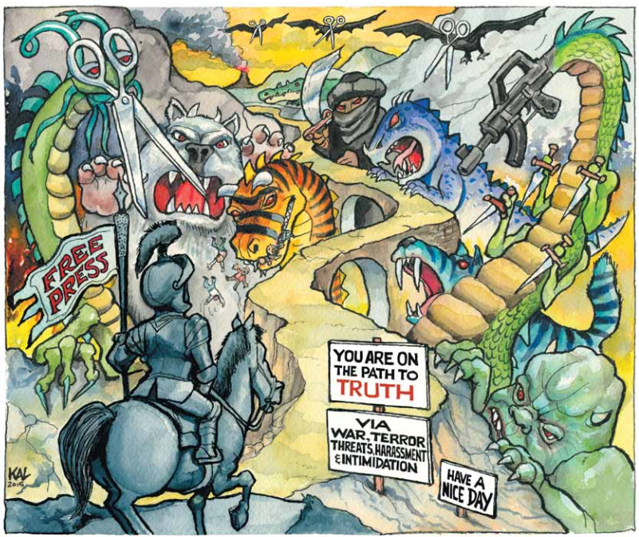
2015 Freedom House Report on Press Freedom “Freedom of the Press under Assault”
Freedom House captures the threat that a free press poses to authoritarians throughout the world, even those who reside in democracies, on its cover of its 2015 report on Freedom of the Press
Notes:
Freedom House Report on Freedom of the Press: https://freedomhouse.org/sites/default/files/FreedomofthePress_2015_FINAL.pdf
Excerpt from the Freedom House report regarding crackdowns on press freedom in democracies: There is renewed global interest in the values of free expression following a spate of horrific violence against journalists, notably the IS murders of James Foley, Steven Sotloff, and most recently Japanese reporter Kenji Goto, as well as the January 2015 attack on Charlie Hebdo in Paris. Although the public seems more attuned to the dangers faced by journalists on a daily basis, it is not yet clear what impact these killings will have on the struggle for press freedom, or whether the outpouring of support for free expression will be sustained.
In France, the government is considering new legislation to crack down on hate speech online—a commendable impulse at first glance, but one that poses a potential threat to free expression and offers no guarantee of reducing the tensions that have led to violence. Indeed, while the worst assaults on global access to news and information come from authoritarian states, militant groups, and organized crime, democratic governments risk adding to the problem with overzealous responses to hate speech and propaganda.
Such responses are misguided. Censorship is ineffective and often counterproductive as an antidote to extremism, and its limited utility cannot justify the infringement of a fundamental democratic value like freedom of expression. Unfettered access to information—about politics, religion, corruption, and the countless other potentially sensitive topics that have a direct impact on people’s lives—is a central pillar of any free society because it enables individuals to evaluate such questions for themselves, rather than through a filter devised by those in power. It allows citizens to demand accountability from their own governments, to debunk propaganda and learn the ugly truth about extremist movements, and to advocate for social change and political
reform as they see fit. Restrictions on expression may be a politically expedient way to react to public discontent and insecurity, but a long-term solution demands open debate, the complete exposure and analysis of odious views, the development of persuasive counterarguments, and the implementation of policies to address underlying grievances and social ills.

Slide 7
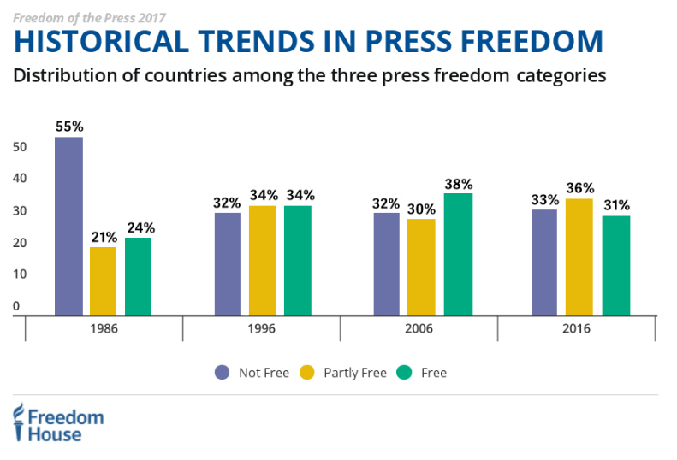
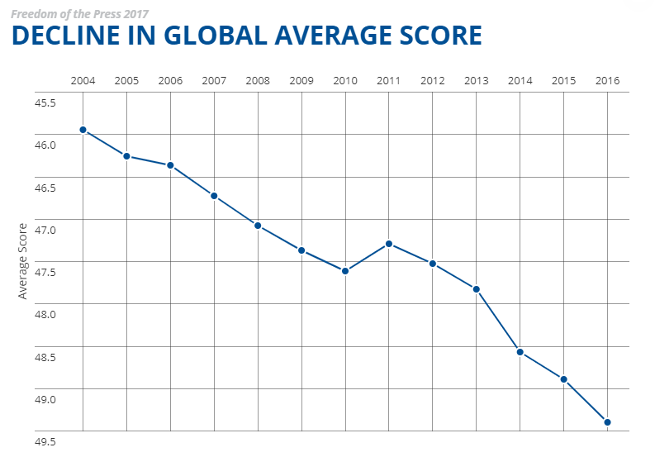
2017 Freedom House Report on Press Freedom “Press Freedom’s Dark Horizon”
Press freedom declined from 2006 to 2016
Even in Europe and in America, press freedom declined
What is most important to an authoritarian regime is to control the flow of information to the people—this goal results in an assault on freedom of the press
Counterintuitive Scaling
A higher number indicates more hostility toward a free press, worldwide. A lower number represents greater protection for a free press. The average score worldwide is declining over time
Notes:
Freedom House scale of press freedom: 0 to 30 (Free Press), 30 to 60 (Partly Free Press), 60 to 100 (No Free Press) – the scale is counterintuitive. A higher number indicates less press freedom. A lower number indicates more press freedom.
2017 Freedom of the Press: https://freedomhouse.org/report/freedom-press/freedom-press-2017
2015 Freedom of the Press
https://freedomhouse.org/report/freedom-press-2015/harsh-laws-and-violence-drive-global-decline#.VUQY1_CYGoY
Below is a cut and paste from Freedom House Report on Freedom of the Press (2015).
Conditions for the media deteriorated sharply in 2014, as journalists around the world faced mounting restrictions on the free flow of news and information—including grave threats to their own lives.
Governments employed tactics including arrests and censorship to silence criticism. Terrorists and other non-state forces kidnapped and murdered journalists attempting to cover armed conflicts and organized crime. The wealthy owners who dominate private media in a growing number of countries shaped news coverage to support the government, a political party, or their own interests. And democratic states struggled to cope with an onslaught of propaganda from authoritarian regimes and militant groups.
Freedom of the Press 2015, the latest edition of an annual report published by Freedom House since 1980, found that global press freedom declined in 2014 to its lowest point in more than 10 years. The rate of decline also accelerated drastically, with the global average score suffering its largest one-year drop in a decade. The share of the world’s population that enjoys a Free press stood at 14 percent, meaning only one in seven people live in countries where coverage of political news is robust, the safety of journalists is guaranteed, state intrusion in media affairs is minimal, and the press is not subject to onerous legal or economic pressures.
Worst of the Worst
The world’s 10 worst-rated countries and territories, with scores of between 90 and 100 points, were Belarus, Crimea, Cuba, Equatorial Guinea, Eritrea, Iran, North Korea, Syria, Turkmenistan, and Uzbekistan. Crimea—analyzed separately for the first time in the current edition—and Syria joined the bottom-ranked cohort in 2014. In these settings, independent media are either nonexistent or barely able to operate, the press acts as a mouthpiece for the regime, citizens’ access to unbiased information is severely limited, and dissent is crushed through imprisonment, torture, and other forms of repression. Crimea became subject to Russian press laws after its occupation and annexation in early 2014, and its media faced restrictive regulations and widespread violence. Iran continues to earn its place among the Worst of the Worst as one of the world’s leading jailers of journalists, including Washington Post correspondent Jason Rezaian, who has been detained without charge since July 2014.
Persistent concerns in the United States: The United States’ score fell by one point, to 22, due to detentions, harassment, and rough treatment of journalists by police during protests in Ferguson, Missouri. Meanwhile, press freedom advocates remained concerned about certain practices and policies of the federal government, including the Obama administration’s relatively rigid controls on the information coming out of the White House and government agencies. Although the U.S. Justice Department said in December that it would no longer seek to compel New York Times journalist James Risen to reveal a source in a long-running case, the Obama administration has used the 1917 Espionage Act to prosecute alleged leaks of classified information eight times, more than all previous administrations combined. Revelations of surveillance that included the bulk collection of communications data by the National Security Agency (NSA) and the targeted wiretapping of media outlets continued to reverberate in 2014, as fears of monitoring and the aggressive prosecution of alleged leakers made journalists’ interactions with administration officials and potential sources more difficult.
Increased use of restrictive laws
Several countries in 2014 passed security or secrecy laws that established new limits on speech and reporting. After a coup in May, Thailand’s military government suspended the constitution, imposed martial law, shut down media outlets, blocked websites, and severely restricted content. Aggressive enforcement of the country’s lèse-majesté laws also continued in 2014, and after the coup alleged violators were tried in military courts.
In Turkey, the government repeatedly sought to expand the telecommunications authority’s power to block websites without a court order, though some of the more aggressive legal changes were struck down by the Constitutional Court. Other legislation gave the National Intelligence Organization (MIT) vast powers of surveillance and unfettered access to virtually any information held by any entity in the country. The amendments also criminalized reporting on or acquiring information about MIT.
A Russian law that took effect in August placed new controls on blogs and social media, requiring all sites with more than 3,000 visitors a day to register with the state telecommunications agency as media outlets. This status made them responsible for the accuracy of posted information, among other obligations.
Detentions and closures under existing security or emergency laws also increased in 2014. Azerbaijan was one of the worst offenders, with nine journalists in prison as of December 1. Over the course of that month, the authorities detained prominent investigative journalist Khadija Ismayilova of U.S.-funded Radio Free Europe/Radio Liberty (RFE/RL), raided and closed RFE/RL’s offices in the country, and interrogated the service’s local employees. A number of well-known media advocacy groups were also forced to close during the year.
In Egypt, a court sentenced three Al-Jazeera journalists to seven or more years in prison on charges of conspiring with the outlawed Muslim Brotherhood to publish false news. The convictions followed a farcical trial in which prosecutors presented no credible evidence. While all three were freed or released on bail in early 2015, at least nine journalists remain in jail on terrorism charges or for covering the Brotherhood.
Ethiopia’s government stepped up its campaign against free expression in April 2014 by arresting six people associated with the Zone 9 blogging collective and three other journalists. In July, they were charged with inciting violence and terrorism. Myanmar, which had taken several positive steps in recent years, suffered declines in 2014 due in part to an increase in arrests and convictions of journalists. In July, four reporters and the chief executive of the Unity Weekly News were sentenced to 10 years in prison and hard labor, later reduced to seven years, under the colonial-era Official Secrets Act for reporting on a possible chemical weapons facility.
Such restrictive laws are not only utilized in authoritarian environments. Mexico’s new telecommunications law drew widespread objections from press freedom advocates due to provisions allowing the government to monitor and shut down real-time blogging and posting during social protests. South African authorities expanded their use of the apartheid-era National Key Points Act to prevent investigative journalists from reporting on important sites or institutions, particularly when probing corruption by political figures. In South Korea, President Park Geun-hye’s administration increasingly relied on the National Security Law to suppress critical reports, especially regarding the president’s inner circle and the Sewol ferry disaster.
Physical violence and inaccessible areas
The world’s growing number of areas that are effectively off limits for journalists include parts of Syria and Iraq controlled by Islamic State (IS) extremists, states in northeastern Nigeria where Boko Haram is active, much of conflict-racked Libya, and Egypt’s restive Sinai Peninsula. In Mexico, Honduras, and other Central American countries, intimidation and violence against journalists continued to soar during the year, as gangs and local authorities sought to deter reporting on organized crime and corruption in their territory.
Seventeen journalists were killed in Syria alone in 2014, according to the Committee to Protect Journalists (CPJ). The death toll, coupled with the high-profile murders of American freelance journalists James Foley and Steven Sotloff by IS militants, served as a stark reminder that local reporters—who make up the vast majority of the casualties—and freelancers do not have the extensive security safeguards afforded to full-time staff at large news organizations like the New York Times. To help address the problem, major outlets and advocacy groups established global safety principles and practices in early 2015.
While some parts of the world are rendered inaccessible mostly by chaotic violence, others are deliberately barred to most reporters by repressive governments. Prime examples include China’s Tibet and Xinjiang regions, Tajikistan’s Gorno-Badakhshan Autonomous Region, Russian-occupied Crimea, and certain ethnic minority areas in Myanmar. Citizen journalists, activists, and ordinary residents have managed to disseminate some information about conditions in these regions, but it is no substitute for unfettered reporting by professionals, and it is often easier to send news to the outside world than to reach audiences within the affected area.
Street protests, though less deadly than armed conflicts, frequently proved dangerous for reporters to cover in 2014. During the prodemocracy demonstrations that broke out in Hong Kong in September, journalists faced a sharp rise in violence, including multiple assaults on reporters near protest sites. In Venezuela, journalists became targets during clashes linked to the widespread social protests that swept the country in the first half of the year. Reporters in Brazil also encountered violence at protests before and during the World Cup; in February, a cameraman died after being hit in the head with an explosive. In Ukraine, in addition to four journalist deaths and other violence associated with the separatist conflict in the east, one journalist was killed and at least 27 others were injured at the height of confrontations between protesters and police in the capital in February.
Pressure through ownership
In Russia and Venezuela, the media sector is increasingly owned by the state, private-sector cronies of the political leadership, or business interests that “depoliticize” their outlets by suppressing content that is critical of the government. In July, Venezuela’s oldest independent daily, El Universal, was sold to new owners. The move came on the heels of ownership changes at two other major private media companies in the country, Cadena Capriles and Globovisión. In all three cases, respected reporters have left or been suspended since the ownership changes, primarily due to shifts in the editorial line that affected news coverage.
While somewhat more media diversity exists in countries like Turkey and Ecuador, political leaders have steadily tamed once-independent outlets, using various forms of pressure against private owners and creating media sectors that are firmly tilted in the ruling party’s favor.
In Greece, the new public broadcaster has faced allegations of political interference in hiring and editorial content. Hungary remained a country of concern in 2014, as the administration of Prime Minister Viktor Orbán continued to exert pressure on media owners to influence coverage. Dozens of media workers protested the dismissal of the editor in chief of Origo, a news website, after it published an article on alleged misuse of state funds.
Increased use of propaganda by states and nonstate actors
Among the most troubling trends identified in 2014 was the more active and aggressive use of propaganda—often false or openly threatening—to warp the media environment and crowd out authentic journalism.
This phenomenon was especially pronounced in Russia, where state-controlled national television stations broadcast nonstop campaigns of demonization directed at the internal opposition, neighboring countries whose policies have displeased Moscow, and the broader democratic world. Russian media played a major role in preparing the Russian public for war with Ukraine. As Dmitriy Kiselyov, head of the Kremlin’s international news enterprise, asserted in April 2014, “Information wars have already become standard practice and the main type of warfare. The bombers are now sent in after the information campaign.”
Neighboring countries have grappled with the problem of Russian propaganda, in some cases resorting to censorship. Ukrainian authorities, facing a military invasion, suspended the retransmission of at least 15 Russian television channels by cable operators. Authorities in Lithuania, Latvia, and Moldova—whose breakaway territory of Transnistria is supported by Moscow—imposed suspensions or fines on some Russian stations for reasons including incitement to war, disseminating historical inaccuracy, and lack of pluralism of opinions in news content. The government of Estonia did not follow suit, instead approving the creation of a Russian-language public channel, set to launch in 2015, as a means of countering Kremlin disinformation with honest reporting. Latvia and Lithuania also signaled plans to expand Russian-language public programming.
Like the Kremlin, China’s Communist Party leaders used state-controlled media to propagate official views and vilify their perceived enemies. State outlets trumpeted the persona and slogans of President Xi Jinping while airing televised confessions and “self-criticisms” by detained journalists, with both phenomena drawing comparisons to the Mao era. To ensure that all media toed the line, the party’s propaganda department issued almost daily directives ordering news outlets and websites to use only information from the official Xinhua News Agency for coverage of breaking developments.
Propaganda is not used exclusively by national governments. Militant groups including IS have established sophisticated media operations with potential audiences around the world, taking advantage of popular social-media tools and even satellite television. Democratic governments have been hard pressed to combat messages that openly advocate violence without restricting privacy, freedom of expression, and access to information for their citizens.

Slide 8

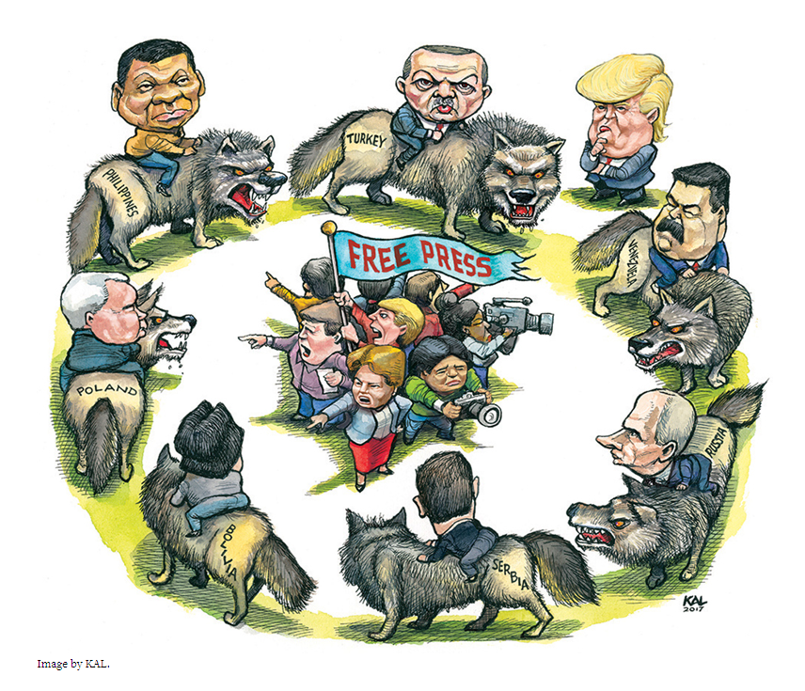
2017 Freedom House Report on Press Freedom “Press Freedom’s Dark Horizon”
Freedom House captures the threat that a free press poses to authoritarians throughout the world, even those who reside in democracies. Even the U.S. under President Trump is shown as a threat to press freedom, though not nearly as threatening as some of the authoritarian leaders portrayed in the cartoon
Notes:
Source: https://freedomhouse.org/report/freedom-press/freedom-press-2017
Here is what Freedom House has to say about President Trump
“No U.S. president in recent memory has shown greater contempt for the press than Trump in his first months in office. He has repeatedly ridiculed reporters as dishonest purveyors of “fake news” and corrupt betrayers of the national interest. Borrowing a term popularized by Soviet leader Joseph Stalin, Trump has labeled the news media as “enemies of the people.” His senior White House adviser described journalists as “the opposition party.”
“Such comments suggest a hostility toward the fundamental principles and purposes of press freedom, especially the news media’s role in holding governments to account for their words and actions—as opposed to the government holding the media to account. They also raise concern that the U.S. president may, in effect, be offering a license to political leaders elsewhere who have cracked down on the media as part of a larger authoritarian playbook.”

Slide 9
Freedom Under Attack
The Threat that Free Speech Poses to the Values of Authoritarianism
Notes:
Gina Carano v. Susan Sarandon
Disney Fans Slam Susan Sarandon for Posting Same Quote as Fired Gina Carano (newsweek.com) https://www.newsweek.com/gina-carano-disney-tweet-fired-susan-sarandon-1754429

Slide 10
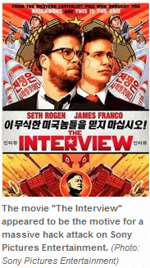
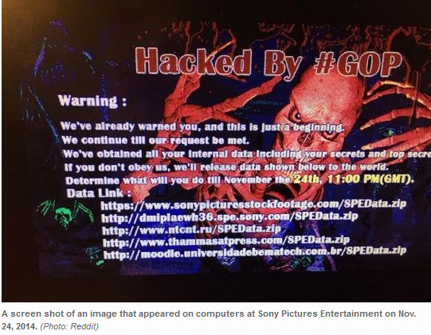
North Korea’s Hack of Sony Pictures The Threat Freedom Poses to the Authoritarian Regime in North Korea
North Korea was so threatened by the 2014 movie, “The Interview,” which made fun of the Kim Jong-Un, that it hacked the computers of Sony Pictures, releasing private information to the internet, and threatened more attacks if Sony decided to show the movie
Notes:
http://www.usatoday.com/story/news/nation-now/2014/12/18/sony-hack-timeline-interview-north-korea/20601645/ -- a timeline of events detailing the Sony Pictures hack
On Nov. 24th (2014), a group called the Guardians of Peace (GOP) hacked into Sony Pictures’ computer systems, locked its employees out of their computers, and released stolen emails and not-yet-released movies on the internet (e.g., Not Alice, Spectre (a James Bond movie). On Dec. 16th (2014), the hacker sent another message to Sony warning “9/11 style attacks” if Sony released the movie, “The Interview,” which was a parody of the North Korean leader, Kim Jong-Un. The movie was about a CIA plot to assassinate the North Korean movie, but it was a comedy. In response, between Dec. 16th and Dec. 23rd, Sony decided not to release the movie, not even as a DVD. The movie was scheduled to premier nationwide on Christmas Day (2014). Even theaters, namely, AMC and Regal, announced it would not show the movie, fearing a terrorist attack.
On Dec. 19th, the FBI confirmed that North Korea was behind the hack of Sony computer systems. On Dec. 22nd, there was a 10 hour internet outage in North Korea. The U.S. did not take responsibility for the outage, perhaps it was a coincidence or perhaps internet outage was in retaliation by our government. On Jan. 2nd (2015), President Obama added sanctions against North Korea; the sanctions targeted NK officials, denying them access to frozen bank accounts, as well as entry into the U.S.
Sony’s decision not to release the movie was almost universally criticized, by movie actors such as George Clooney and Ben Stiller, as well as by most political commentators in America. Sony was accused of caving to terrorist threats, and the criticism was so universal that Sony eventually decided to release the movie on YouTube, Google Play, Microsoft Xbox Video, and on www.seetheinterview.com on Christmas Day (2014). Also, the Alamo Draft House and Plaza Atlanta theaters decided to carry the movie; some 330 movie theaters screened the movie on Dec. 25th (2014).

Slide 11
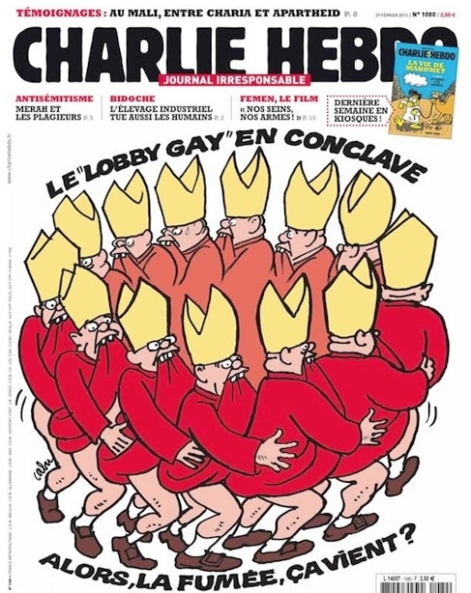
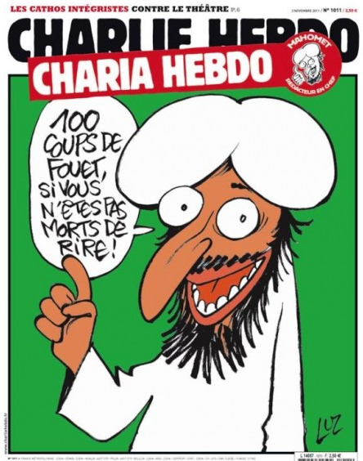
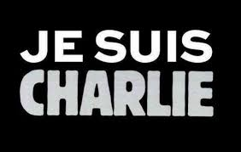
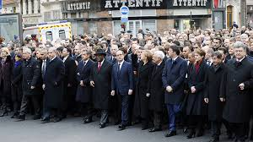
Charlie Hebdo Terrorist Attack The Threat Freedom Poses to Religious Authoritarians (ISIS, Al Qa’ida, etc.)
In Jan. 2015, 2 terrorists attacked a satirical French magazine, Charlie Hebdo, for making fun of Islam, killing 8 members of its editorial staff, including its editor; 2 others attacked a Jewish grocery two days later, killing 4 people
In the wake of the attack, world leaders came to France to show their support for press freedom, even for offensive publications like Charlie Hebdo
Notes:
http://www.theguardian.com/world/2015/jan/09/-sp-charlie-hebdo-timeline-events
http://www.cnn.com/2015/01/08/europe/charlie-hebdo-attack-timeline/
http://en.wikipedia.org/wiki/Charlie_Hebdo
Here’s what Secretary of State, John Kerry said when comparing the Charlie Hebdo terrorist attack in Jan. 2015 to the terrorist attack at 6 locations in Paris in Nov. 2015:
"There's something different about what happened from Charlie Hebdo, and I think everybody would feel that. There was a sort of particularized focus and perhaps even a legitimacy in terms of -- not a legitimacy, but a rationale that you could attach yourself to somehow and say, 'OK, they're really angry because of this and that,'" Kerry said during remarks at the U.S. Embassy in Paris.
"This Friday was absolutely indiscriminate. It wasn't to aggrieve one particular sense of wrong. It was to terrorize people. It was to attack everything that we do stand for. That's not an exaggeration," Kerry added.
------------------------------------------------------------------------------------
https://www.vox.com/2015/1/12/7531979/obama-kerry-paris-march – Here is an article on then President Obama not attending the march in Paris following the attacks on Charlie Hebdo
No top-level US official attended the rally of world leaders in Paris, France, following the Jan. 2015 terrorist attack on Charlie Hebdo headquarters. The rally was to show the world’s support for freedom of expression, as well as its opposition to terrorism. Neither President Obama, Vice President Joe Biden, Secretary of State John Kerry, nor Attorney General Erik Holder attended. The official reason was security concerns and short notice. Apparently, for Obama to march in the open streets of Paris would require so much security that it would have limited the number of people at the rally. I believe Obama did not go because he objects to insulting Muslims. His foreign policy doctrine toward the Muslim-majority world actually had a name, “mutual respect, mutual interests.” He believed if America paid more respect to Muslims, then we would get more cooperation in return as we fight terrorism and other issues of mutual interest to the U.S. and Muslim-majority countries. Charlie Hebdo was not respectful to Islam, nor to any religion, and it would run counter to the message Obama was trying to send to the greater Muslim world had he marched in support of Charlie Hebdo.
------------------------------------------------------------------------------------
Said and Cherif Kouachi, two brothers, carried out the attack on Charlie Hebdo. They were trained by Al Qaeda in Yemen, which later took credit for the attack. Said and Cherif shouted “Allahu akbar” (God is great) and the “Prophet is avenged” as they killed the editors and cartoonist at Charlie Hebdo. They were tracked down two days later, bunkered in a printing shop near the Paris airport, where they were killed by French security forces. At the same time the Kouachi brothers were under siege near the Paris airport, a man named Amedy Coulibaly took hostages at a Jewish grocery store in Paris. He killed four (4) hostages before being killed by French police. His accomplice, Hayat Boumeddiene escaped as other hostages ran out of the store.
In the graphics on the slide, one is making fun of gay priests in the Catholic Church. The other depicts the Prophet Mohammad saying, “100 lashes if you don’t die of laughter first.” Charlie Hebdo is a left-wing publication that mocks just about everything and everybody, Christians and Muslims, political leaders, particularly in France, and so much more. Charlie Hebdo is an “in your face” publication.
In 2011, the Charlie Hebdo headquarters were bombed, in response to the magazine cover of the Prophet Mohammad (shown on the slide above). Charlie Hebdo’s cover, “Charia Hebdo,” was in response to the recent imposition of Sharia Law in Libya and the recent election victory of an Islamist party in Tunisia.
In 2006, a Danish newspaper published cartoons of the Prophet Mohammad, which sparked violence against Danish Embassies in a number of Arab and Muslim countries. Charlie Hebdo reprinted the 12 cartoons in its magazine, in a show of solidarity, one of which showed the Prophet Mohammad with a bomb in his turban. French Muslim organizations sued in French courts, claiming the cartoons were racist. Charlie Hebdo won the case in court, with the court citing that the cartoons made fun of fundamentalists and not mainstream Muslims.
The Pulse Nightclub Shooting
In June 2016, Omar Mateen shot and killed 49 people, injuring another 58, at the Pulse Nightclub in Orlando, Florida. Pulse served the gay community, and Mateen had been to the bar on a few occasions. Some claim that he had had a gay relationship with someone named “Miquel.” His wife reportedly told the FBI that her husband was gay. Moreover, just prior to the incident, Mateen had pledged allegiance to ISIS in Syria and Iraq, and he claimed the mass murder was in retaliation for the killing of an ISIS leader.
At the time, this was the worst mass shooting in U.S. history (the Las Vegas shooting in 2017 resulted in more deaths).
Mateen was conflicted with being a Muslim and gay. Homosexuality goes against religious values, and it was this conflict that likely drove Mateen to target a gay nightclub.
Beheading in France (Oct 2020)
https://www.msn.com/en-us/news/world/chechen-leader-macron-s-stance-on-muhammad-cartoons-forcing-people-into-terrorism/ar-BB1arWdp?ocid=msedgntp
https://www.realclearpolitics.com/articles/2020/11/01/standing_with_france_and_free_speech_after_terror_attack.html

Slide 12
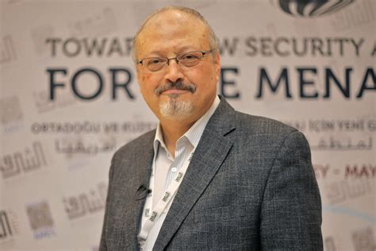
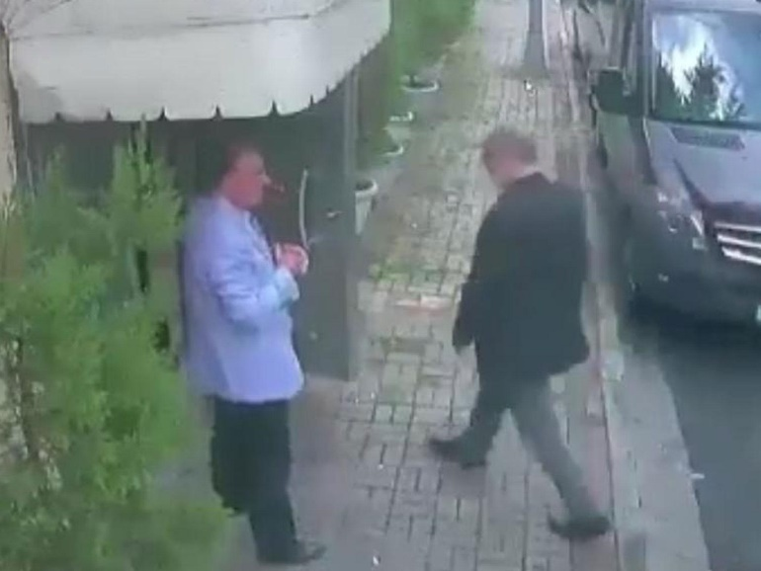
Saudi Arabia’s Murder of Jamal Khashoggi The Threat Freedom Poses to the Authoritarian Monarchy in Saudi Arabia
On Oct. 2nd (2018), Jamal Khashoggi, a reporter for the Washington Post of Saudi decent, entered the Saudi Arabian consulate in Turkey, and was killed by 15-man team sent from Saudi Arabia
Khashoggi had been critical of the reforms initiated by the Crown Prince, Mohammad bin Salman (MBS).
In Nov. 2018, the CIA concluded that MBS had ordered the murder of Khashoggi.
Congress wanted to hold MBS accountable, but President Trump refused to do so, given that the U.S. and Saudi Arabia are allies and President Biden decided not to enact sanctions on MBS as a world leader, which gives him immunity
Notes:
The Saudi’s first denied that Khashoggi had been killed. They even hired a double to walk out of the Saudi consulate, wearing Khashoggi’s clothes. But international pressure forced the Saudi’s to admit to the “accidental” death, and then go into damage control, by trying to “nip the problem in the bud” by first arresting 18 Saudi’s involved in the murder and then sentencing 5 of them to death.
https://www.washingtonpost.com/opinions/global-opinions/jamal-khashoggi-what-the-arab-world-needs-most-is-free-expression/2018/10/17/adfc8c44-d21d-11e8-8c22-fa2ef74bd6d6_story.html?noredirect=on&utm_term=.065d2031572f – Here’s an article that was printed in the Washington Post about 2 weeks after Khashoggi was killed. It is Khashoggi’s last article prior to his murder, critical of free press rights in the Arab world.
A note from Karen Attiah, Global Opinions editor
I received this column from Jamal Khashoggi’s translator and assistant the day after Jamal was reported missing in Istanbul. The Post held off publishing it because we hoped Jamal would come back to us so that he and I could edit it together. Now I have to accept: That is not going to happen. This is the last piece of his I will edit for The Post. This column perfectly captures his commitment and passion for freedom in the Arab world. A freedom he apparently gave his life for. I will be forever grateful he chose The Post as his final journalistic home one year ago and gave us the chance to work together.
I was recently online looking at the 2018 “Freedom in the World” report published by Freedom House and came to a grave realization. There is only one country in the Arab world that has been classified as “free.” That nation is Tunisia. Jordan, Morocco and Kuwait come second, with a classification of “partly free.” The rest of the countries in the Arab world are classified as “not free.”
As a result, Arabs living in these countries are either uninformed or misinformed. They are unable to adequately address, much less publicly discuss, matters that affect the region and their day-to-day lives. A state-run narrative dominates the public psyche, and while many do not believe it, a large majority of the population falls victim to this false narrative. Sadly, this situation is unlikely to change.
The Arab world was ripe with hope during the spring of 2011. Journalists, academics and the general population were brimming with expectations of a bright and free Arab society within their respective countries. They expected to be emancipated from the hegemony of their governments and the consistent interventions and censorship of information. These expectations were quickly shattered; these societies either fell back to the old status quo or faced even harsher conditions than before.
My dear friend, the prominent Saudi writer Saleh al-Shehi, wrote one of the most famous columns ever published in the Saudi press. He unfortunately is now serving an unwarranted five-year prison sentence for supposed comments contrary to the Saudi establishment. The Egyptian government’s seizure of the entire print run of a newspaper, al-Masry al Youm, did not enrage or provoke a reaction from colleagues. These actions no longer carry the consequence of a backlash from the international community. Instead, these actions may trigger condemnation quickly followed by silence.
As a result, Arab governments have been given free rein to continue silencing the media at an increasing rate. There was a time when journalists believed the Internet would liberate information from the censorship and control associated with print media. But these governments, whose very existence relies on the control of information, have aggressively blocked the Internet. They have also arrested local reporters and pressured advertisers to harm the revenue of specific publications.
There are a few oases that continue to embody the spirit of the Arab Spring. Qatar’s government continues to support international news coverage, in contrast to its neighbors’ efforts to uphold the control of information to support the “old Arab order.” Even in Tunisia and Kuwait, where the press is considered at least “partly free,” the media focuses on domestic issues but not issues faced by the greater Arab world. They are hesitant to provide a platform for journalists from Saudi Arabia, Egypt and Yemen. Even Lebanon, the Arab world’s crown jewel when it comes to press freedom, has fallen victim to the polarization and influence of pro-Iran Hezbollah.
The Arab world is facing its own version of an Iron Curtain, imposed not by external actors but through domestic forces vying for power. During the Cold War, Radio Free Europe, which grew over the years into a critical institution, played an important role in fostering and sustaining the hope of freedom. Arabs need something similar. In 1967, the New York Times and The Post took joint ownership of the International Herald Tribune newspaper, which went on to become a platform for voices from around the world.
My publication, The Post, has taken the initiative to translate many of my pieces and publish them in Arabic. For that, I am grateful. Arabs need to read in their own language so they can understand and discuss the various aspects and complications of democracy in the United States and the West. If an Egyptian reads an article exposing the actual cost of a construction project in Washington, then he or she would be able to better understand the implications of similar projects in his or her community.
The Arab world needs a modern version of the old transnational media so citizens can be informed about global events. More important, we need to provide a platform for Arab voices. We suffer from poverty, mismanagement and poor education. Through the creation of an independent international forum, isolated from the influence of nationalist governments spreading hate through propaganda, ordinary people in the Arab world would be able to address the structural problems their societies face.

Slide 13
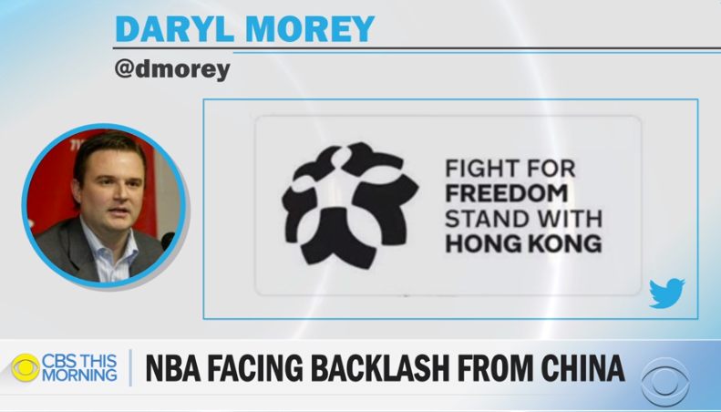
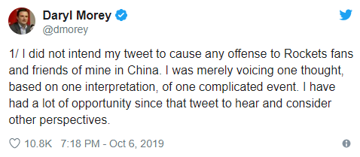
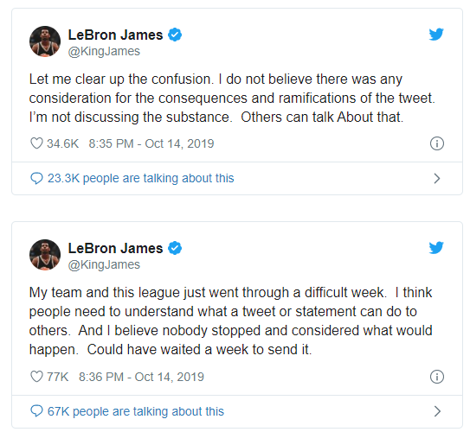
Houston Rockets Tweet on Hong Kong (2019) The Threat Freedom Poses to Authoritarian Communists in China
The National Basketball Association (NBA) has expanded its market to China, where Chinese government-controlled TV broadcasts NBA games, for a fee paid to the NBA.
Daryl Morey, then the GM of the Houston Rockets, tweeted support for the pro-freedom protesters in Hong Kong, China.
The Chinese government tolerates no criticism of its authoritarian policies and refused to show NBA games (in the 2019 season), resulting in the loss of revenue (millions of $$$) for the NBA
Notes:
Source of Graphic: https://www.cbsnews.com/news/daryl-morey-tweet-firestorm-houston-rockets-gm-tweet-backing-hong-kong-protesters-over-china/
The Situation in Hong Kong
https://www.bbc.com/news/world-asia-china-48607723 – This article gives historical and contemporary context to the protests in Hong Kong, and the Chinese crackdown in response.
Reaction to Morey’s Tweet
https://www.usatoday.com/story/sports/nba/lakers/2019/10/14/lebron-james-addresses-daryl-morey-china-tweet-clarifies-remark/3982048002/
Cut and paste from link above:
“NBA Commissioner Adam Silver sounded sympathetic for those in China that were offended by Morey's tweet and stressed that his remarks did not capture the league’s views. Still, Silver also defended Morey’s freedom of speech.
China did not like the NBA’s reaction. CCTV, a Chinese state-run television station, declined to broadcast the Lakers-Nets games in Shanghai and Shenzhen. Telecom company Tencent canceled Rockets coverage and all NBA preseason games. The Chinese government pressured the NBA to cancel an NBA Cares event with the Nets. Various Chinese companies have announced they will end partnerships with various NBA stars.”

Slide 14
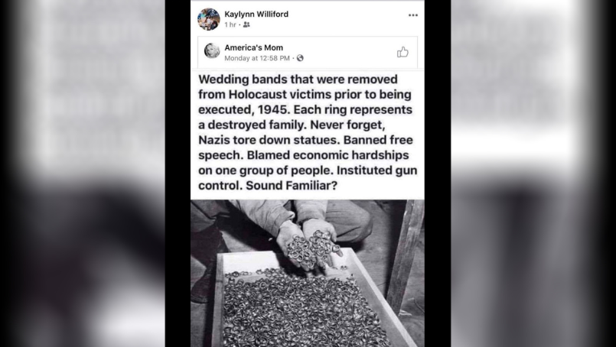
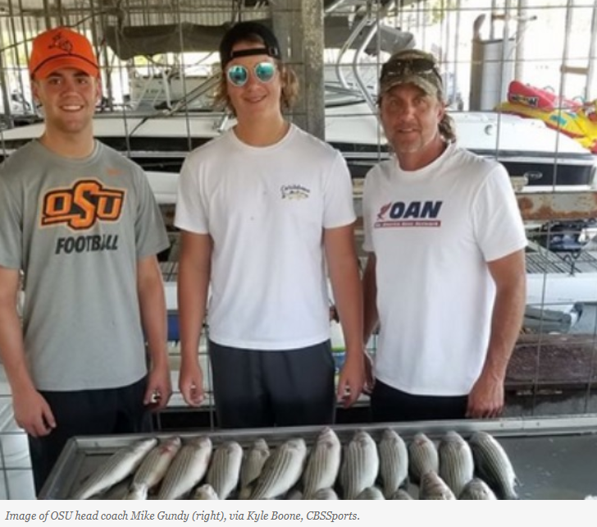
Silencing Offensive Speech in the U.S. (2020) The Threat Freedom Poses to “Cancel Culture” in America
Ideologically conservative free speech and expression are increasingly being “canceled” in America, as “hate speech” or as “racist” or as unacceptably “offensive”
Kaylynn Williford, a prosecutor in Harris County DA’s office since 1992 (28 years), resigned after reposting a Facebook post, analogizing the Nazi Holocaust to the anarchy occurring in conjunction with the George Floyd protest rallies
Mike Gundy, head coach of the OSU football team, essentially renounced his conservative views and took a $1 million per year pay cut after being called out for wearing a One America News (OAN) T-shirt
Notes:
https://abc13.com/kaylynn-williford-harris-county-prosecutor-racist-post-district-attorneys-office/6281214/ -- June 29 2020 – Kaylynn Williford was a career attorney in the Harris County DA’s office for 28 years…she reposted a Holocaust remembrance meme on Facebook, likening the violent protesters during the George Floyd and Juneteenth rallies to Nazis. Clearly, she was stating her opposition to the violent protests and the crime of pulling down statues (outside the proper channels, which is by decision of a city council or other governing entity). Perhaps the Nazi analogy is overused, which was probably the case here, but the violent protesters represent anarchy and some of their leaders are Marxist and communist in ideology and neither anarchists or Marxists embrace democratic values, so this would seem to be a valid point that Williford tried to make. Sadly, Williford’s repost was interpreted as a critique of the Black Lives Matter movement and thus considered racist. Williford resigned her position. Kim Ogg, the elected District Attorney (DA) for Harris County, did not fire Williford, but she suggested that Williford had violated rules of the DA’s office and that her actions would be evaluated by some sort of disciplinary panel, but before Williford went through any disciplinary proceeding, she resigned.
https://www.mediaite.com/sports/oklahoma-state-football-coach-mike-gundy-under-fire-for-wearing-an-oan-shirt-youre-special-dumb/ -- June 15 2020 – This article contained the pic I used on the slide, of Mike Gundy on his 10 June 2020 fishing trip.
https://sports.yahoo.com/mike-gundy-continues-talking-about-oan-tshirt-says-he-was-a-dumbass-for-wearing-it-162726739.html – June 18 2020 – This article gives more on Coach Gundy, about his not knowing the viewpoints of OAN, and also quotes from Chubba Hubbard, star running back and Heisman prospect at OSU, regarding Hubbard’s objections to Coach Gundy wearing the OAN T-shirt.

Slide 15
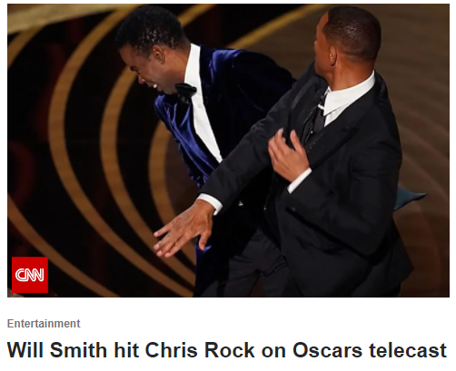
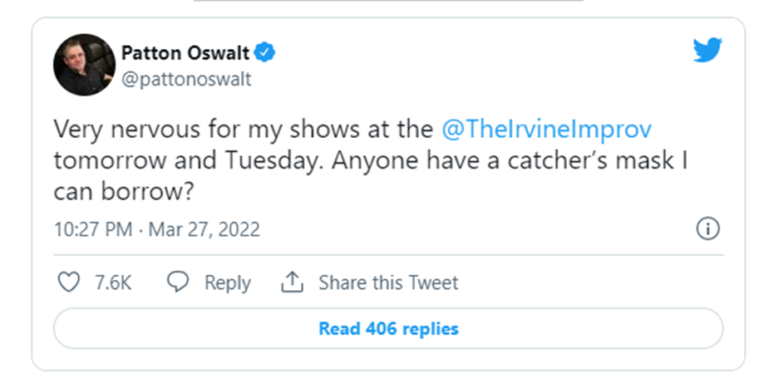
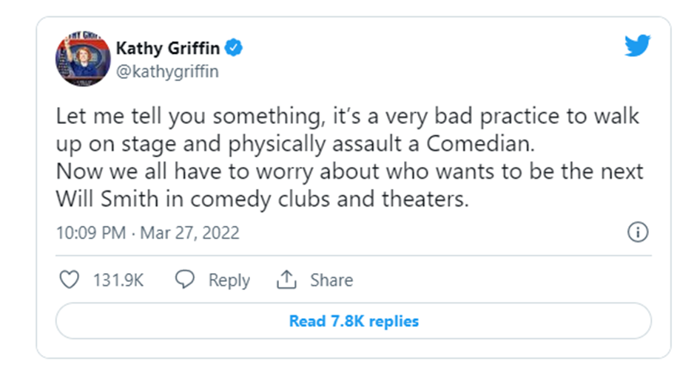
Silencing Offensive Speech in the U.S. (2022) The “Will Smith” Slap at the Academy Awards Ceremony (3/27/2022)
Though Will Smith’s intent may have been to defend his wife’s honor, after Chris Rock made Jada Pinkett Smith the butt of a G.I. Jane joke, “the slap” is another example of our cultural intolerance of offensive free speech. An entire profession (comedians) is under the threat of “cancel culture”
Notes:
https://www.foxnews.com/entertainment/comics-condemn-will-smith-slapping-chris-rock-oscars https://www.foxnews.com/entertainment/comics-condemn-will-smith-slapping-chris-rock-oscars
Comedians respond to Will Smith’s slap of Chris Rock at the 2022 Academy Awards Ceremony.
At the 2022 Academy Awards Ceremony (3/27/2022), Will Smith slapped Chris Rock for this joke, “Jada. G.I. Jane 2. Can’t wait to see it.” Rock was doing a brief stand-up routine prior to announcing the winner of the best documentary. Smith initially laughed at the joke, but his wife (Jada Pinkett Smith) did not laugh and shot Will Smith a look of disapproval (of the joke). Smith then walked up on the stage and slapped Rock. When Smith sat down, he shouted to Rock, “Keep my wife’s fu-king name out of your mouth.” Rock responded, “It’s just a G.I. Jane joke.” Then, Smith shouted even more emphatically the same “keep my wife’s name….out of your mouth.”
The joke was reference to a 1990s movie titled, “G.I. Jane,” in which Demi Moore starred as a female marine recruit, who, because she was a woman, no one thought would make it through basic training. In the movie, Demi Moore had a shaved head, required of all marines during basic training. Jada Pinkett Smith also has a shaved head, because she has alopecia, which causes hair loss (alopecia is much more common in men than in women). Jada took the joke to be poking fun at her medical condition (albeit, not a life-threatening condition), and clearly, she viewed it as insensitive of the psychological pain she has suffered for having hair loss.
Poking fun is a characteristic of comedy, and comedians have been under the threat of cancel culture for many years prior to Will Smith’s slap. College-aged students no longer tolerate comedians for being too offensive with their jokes. It wasn’t always that way. 50 years ago, George Carlin (a filthy-mouthed comedian of that era) could only find an audience for his type of humor on college campuses, but our youth culture has changed in the social-media era of cancel culture. The Will Smith slap is just the latest example of intolerance for offensive free speech, and now comedians are worried about getting potentially assaulted during their shows (as evidenced by the tweets shown on the slide).
Dystopian Authoritarian Societies Are Intolerant of Comedy, Laughing , and other displays of Joy and Happiness
In high school, many school-aged kids read the book, “1984” or “Brave New World,” both of which are staged in dystopian authoritarian societies where no one is allowed to laugh or express any joy. These are fiction novels, but the same is true in real life in North Korea today, and in virtually all other authoritarian societies in history, including in the communist Soviet Union (1917-1991) and in Taliban-controlled Afghanistan (~1989-2001, 2021-present). Extreme authoritarians demand strict allegiance, and laughing and other displays of joy could potentially be directed at the country’s leadership, and making fun of people can be used as a means of discrediting people, so the regime leaders will not tolerate language or expression that could potentially be used to undermine their command over the people.
In America today, we are not there yet, and we might never get to the point of a dystopian authoritarian society, but intolerance of offensive speech that has taken root in our culture today is nevertheless an authoritarian value that could potentially lead to a dystopian state.

Slide 16
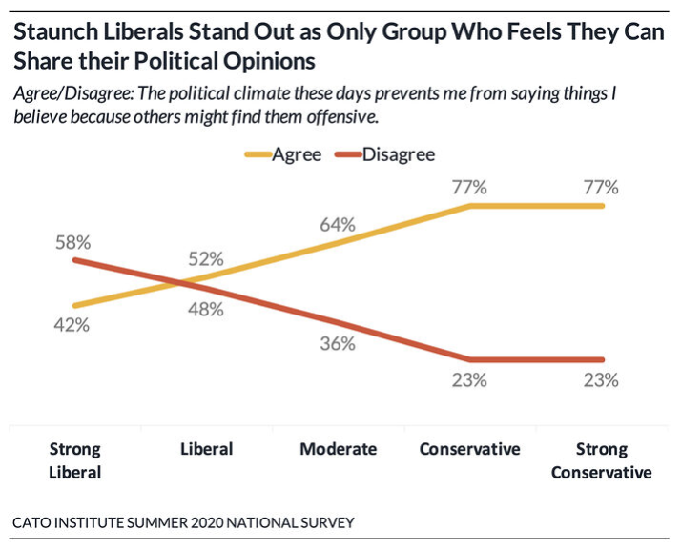
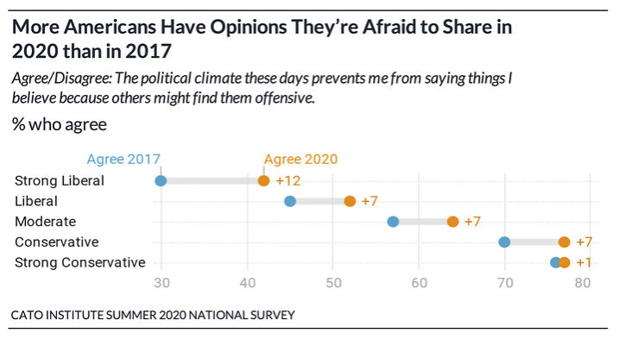
Silencing Offensive Speech in the U.S. (2020) More conservatives feel silenced in America
58% of strong liberals feel comfortable publicly expressing their views, while only 23% of strong conservatives feel that way
Still, even liberals and strong liberals are feeling the constraints of “cancel culture,” experiencing a 7% and 12% increase, respectively, in the % of those who feel silenced since 2017
Notes:
https://www.cato.org/publications/survey-reports/poll-62-americans-say-they-have-political-views-theyre-afraid-share#introduction
Given that “cancel culture” tends to be strongly liberal in ideology, you might think that liberals (and strong liberals) would be very comfortable in publicly expressing their political opinions, but when 52% of liberals and 42% of strong liberals feel that the culture silences them, that tells me that these liberal and strong liberal respondents have some conservative views. We have to keep in mind that no one is 100% pure in ideology. We are mostly liberal or mostly conservative but never or very rarely purely liberal or conservative. So, let’s say that a strong liberal is white and feels uncomfortable about the anti-white sentiment among (mostly white) members of “cancel culture, that “strong liberal” who happens to be white might feel silenced when he or she might want to speak out against the identity politics that is stressed so much amongst “cancel culture.” Let’s say that a strong liberal is black, who is also religious, that person’s religious views might put him or her on the opposite side of “cancel culture” on the issue of homosexuality or on the rights of transgender people, and that person might feel silenced to express his or her views on those subjects. The point here is that a much higher % of conservatives feel silenced by “cancel culture,” given that more of their views are in opposition to those promoted by “cancel culture,” but that said, I must also note that an increasing % of liberals feel silenced as well.
In 2020, at this point in “cancel culture,” those who were being “canceled” (meaning, being fired from their jobs or de-platformed on social media or suffering some other material consequence) were conservatives or liberals who were not liberal enough. So, part of cancel culture at this point in time (2020), was more extreme liberals canceling less extreme liberals.
Regarding colleges and universities at this point in time (2020), some liberal college and university professors had been canceled for not being liberal enough. Conservatives started to push back against cancel culture in the 2021 timeframe (to the present day), and there are cases where liberal college professors were canceled by more conservative college presidents and administrators, e.g., college professors criticizing decisions by more conservative college administrators to go back to the classroom during the COVID crises, when these more liberal professors worried that such policy might subject them to COVID-19.

Slide 17

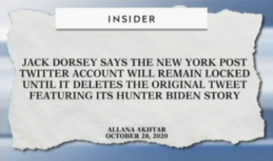
Silencing “Misinformation” in the U.S. (2020) The Role of Social Media (Facebook, Twitter, etc.) in silencing free speech
In 2020, under intense pressure from those who feared that President Trump’s tendency to lie and exaggerate was influencing too many people in America, and pressure from “cancel culture” more generally, Facebook and Twitter began to “flag” or “censor” what they considered to be “misinformation”
Conservatives believe that these social media giants are censoring conservative viewpoints
In 2022, Mark Zuckerberg (CEO of Meta (Facebook)) revealed that the FBI had warned him that the Hunter Biden story, published during the 2020 presidential campaign, was “misinformation”
Notes:
https://www.msn.com/en-us/news/crime/facebook-sued-for-allowing-racist-militias-to-broadcast-call-to-arms-before-kenosha-shooting/ar-BB19lOaZ?ocid=msedgntp – Here is a group that sued Facebook with the intent to urge Facebook to take down materials posted by militias that are allegedly racist and calling for violence in Kenosha. Still, others argue that these miliitas showed up to Kenosha because the police had retreated (or had been ordered to retreat by the mayor), thus allowing the anarchists free reign to loot and destroy property, and the militias were there to protect private businesses, in the absence of police protection.
Explanation of Free Speech Standards
The legal standard for free speech as set by the U.S. Supreme Court, since 1969, has been that speech cannot incite violence or property damage. Let’s say that a leader of a cult instructs his followers to burn down buildings, then the police can arrest the leader of the cult, because his words are likely to incite violence by his gullible followers. But if the speaker is not likely to incite violence, such as if your professor (me) instructed you (my students) to burn down buildings (because my students would just look at me as a fool and not carry out my demands, since I don’t have the sway of a cult leader), then that speaker could not be jailed.
There all legal standards for libel and slander, i.e., written or spoken words that do material harm to another person. Let’s say that I defame one of my colleagues at HCC, and that colleague is fired, then that colleague could file a lawsuit against me because my lies harmed that person (that person would have lost his or her means of making a living, which we all have to do to survive in this world).
In a free society, all other speech is permissible, but these rules don’t apply to a private business (like Twitter, Facebook, or Google). A private business can set its own rules, which is what Twitter has done. The complaint about Twitter, Facebook, and Google is that they have become so integral to our way of communicating that they too should respect the principles of free speech. A similar argument was made about the railroads in the late 1800s. At that time in our history, our society was so dependent on the railroads for transportation, travel, and commerce that eventually the courts in America defined railroads as a “public space,” and at that point, the government stepped in and began to regulate the railroads, such that they could not deny service (e.g., they could not deny service to black people). Something similar might happen to Big Tech, because Republicans and conservatives don’t think it is right to deny their side of their free speech rights, when others can still engage in free speech. Republicans and conservatives view this as censorship, which is a different type of authoritarian behavior (different from Trump’s populist authoritarian tendencies). Democrats and liberals are comfortable with censorship of conservative “misinformation,” but they find Trump’s populist authoritarianism very threatening (e.g., cracking down on illegal immigration, picking a fight with China over trade issues, etc.)
This is a debate that will continue, even after Trump has left the White House.
Big Tech: Twitter Policies
https://www.dailymail.co.uk/news/article-8888985/GOP-senators-slam-Facebook-Twitter-censorship-suppression-conservative-voices.html – This article reports on the Senate hearing into Big Tech’s “censorship” of mostly conservative “misinformation,” e.g., that Joe Biden used his influence to help enrich his son and brother, which is a tweet that is flagged as misinformation v. those who say that the Holocaust was fake, which are tweets that are not flagged as misinformation.
https://www.factcheck.org/2020/11/trump-tweets-flagged-by-twitter-for-misinformation/ -- Here is a list of 9 of Trump’s post-election tweets and why they were flagged by Twitter. Clearly, Trump was wrong to claim he was robbed of an election victory, but the point of the slide above is to highlight the inconsistency of Twitter, flagging Trump’s “misinformation” but other forms of misinformation, such as those who deny that the Holocaust actually happened—these tweets are tolerated as free speech, and free speech can be false (though knowingly false speech that does material harm to another person can be punished as libel or slander).
https://www.stljewishlight.com/news/world/two-weeks-after-twitter-bans-holocaust-denial-twitter-s-ceo-says-it-s-still-allowed/article_47de9db2-333c-520f-8c1b-4897a323737e.html – Jack Dorsey lays out the criteria for Twitter flags: misinformation regarding public health, election integrity, and manipulation of media content. Twitter also has policies against the glorification of violent events, especially against those who are protected minorities, so if someone glorifies the Holocaust, that would be flagged, but if someone questions that the Holocaust existed, that would not be flagged. Dorsey seems to also imply, as reported in this article, that Twitter has a policy against hate speech, which would include a ban on Holocaust denial.
Big Tech: Google Policies
https://www.nationalreview.com/news/google-bans-the-federalist-from-generating-ad-revenue-after-intervention-by-nbc-news/ -- Google demonetizes The Federalist for some sort of racial bias or hate speech (the article does not specify what The Federalist did wrong to violate Google policies). The Federalist is a conservative organization that Donald Trump catered to as president. The Federalist came up with a list of qualified people who could be potentially appointed to the U.S. Supreme Court. Trump chose 3 people from the list as nominees to the U.S. Supreme Court during his term in office.
https://www.thestreet.com/investing/google-boots-zerohedge-federalist-off-ad-platform – Google denies demonetizing The Federalist.
Elon Musk Bid to Purchase Twitter and Restore a Public Square of Free Speech
https://nypost.com/2022/04/14/elon-musk-offers-to-buy-twitter-for-41-billion/ -- In April 2022, Elon Musk offered to purchase Twitter for $40+ billion, and he plans to take the company private, and the restore its public square platform as a forum that conforms to the standards of free speech. The article states that Musk, “publicly trashed the company, which he called “the de facto public town square,” for “failing to adhere to free speech principles fundamentally undermines democracy””

Slide 18
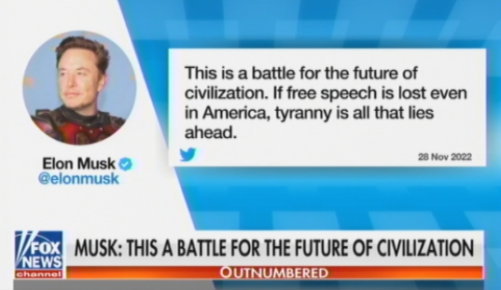
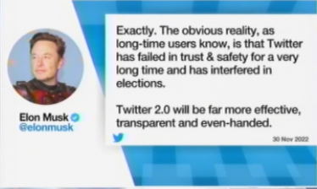
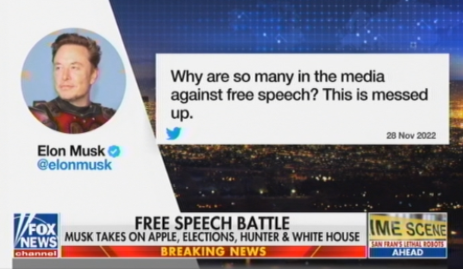
Silencing “Hate Speech” in the U.S. (2022) Elon Musk’s Takeover of Twitter (renamed “X”)
Elon Musk wants to return Twitter to a public space for free speech, but critics argue for bans on “hate speech,” “misinformation,” and “disinformation”
Notes:
Source: Elon Musk tweets copied off of Fox News on 11/30/2022 and 12/1/2022, on Outnumbered, Shannon Bream, and Hannity.
In 2022, Twitter (after Elon Musk took over the company), began to release batches of emails from the FBI, NSA, the Democratic National Committee, and individual Democrats during the 2020-21 timeframe in which these organizations and individuals requested that Twitter censor certain individuals and organizations who were Republican or conservative or both. Here are a few stories on this published since:
How Democrat Adam Schiff abused his power to demand I be kicked off Twitter (nypost.com) https://nypost.com/2023/01/06/how-democrat-adam-schiff-abused-his-power-to-demand-i-be-kicked-off-twitter/?mc_cid=6eaca900c4&mc_eid=52dba34473 – the story of Paul Sperry, who wrote for Real Clear Politics
The New Cultural (Not Legal) Standard for Free Speech
Our culture has increasingly embraced a new standard for free speech, which is to censor “offensive” speech, including “hate speech.” An example of hate speech would be rapper Kanye West’s praising of Adolph Hitler and Nazis in general. Under our current legal definition, Kanye would be able to praise Hitler and Nazis and not get in trouble with the law. The exception would be this. If Kanye had an energized following of supporters, and if there is evidence that Kanye’s praising of Adolph Hitler would incite or likely incite his followers to engage in imminent (that means right now, as soon as they hear the words, they go into action) violence or lawless action. Clearly, Kanye’s praising of Hitler and Nazis in October 2022 did not produce imminent violence or lawless action, so if Kanye were prosecuted under current (legal) free speech standards, he would be found not guilty.
Contrast this to the Oath Keepers’ leadership, who were organized on Jan. 6th 2021 (during the Capitol Riot) to serve as Donald Trump’s army/police force had Trump invoked the “Insurrection Act” (as it turns out, Trump did not invoke the Insurrection Act on Jan. 6th 2021). In Nov. 2022, two of five of the Oath Keepers’ leadership were found guilty in court of “seditious conspiracy.” On Jan. 6th (2021), the Oath Keepers engaged in no violence (except maybe some of their 300 or so members engaged the Capitol police, but what I mean is that they did not pull out their weapons and start shooting in an effort to take control of the Capitol Building on behalf of Donald Trump), but their leadership had an energized following, who would have pulled their weapons and killed had the Oath Keepers leadership commanded them to do so, which is why two of 6 leaders of the Oath Keepers were found guilty of conspiring to incite violence or lawless action (even though their followers ultimately did not engage in violence or lawless action, at least not in the context of trying to takeover the U.S. government). “Conspiracy” means planning and plotting but not actually putting the plan/plot into action, so violence or lawless action does not necessarily have to occur for a leader with an energized following to be found guilty of “seditious conspiracy.”
Here are a couple of articles critical of Elon Musk written by those who subscribe to the new cultural standard for free speech, which would ban “hate speech” and “disinformation” and “misinformation”:
Hate speech dramatically surges on Twitter following Elon Musk takeover, new research shows | CNN Business https://www.cnn.com/2022/12/02/tech/twitter-hate-speech/index.html --
https://www.msn.com/en-us/news/opinion/the-far-right-is-getting-what-it-asked-for/ar-AA14Q8wO?ocid=msedgntp&cvid=677919c52263428bbd278937ca1de1cd –
'Are we free to say Jews will not replace us?' Geraldo Rivera rebuffs Jeanine Pirro's defense of hate speech (msn.com) https://www.msn.com/en-us/news/us/are-we-free-to-say-jews-will-not-replace-us-geraldo-rivera-rebuffs-jeanine-pirro-s-defense-of-hate-speech/ar-AA14PmJx?ocid=msedgntp&cvid=3664f623a45741bbbbf0c20a91883867 – Fox News’ Jeane Pirro defends “hate speech” as legal free speech.
Explanation of the Legal Standard for Free Speech
The legal standard for free speech as set by the U.S. Supreme Court, since 1969, has been that speech cannot incite violence or property damage. Let’s say that a leader of a cult instructs his followers to burn down buildings, then the police can arrest the leader of the cult, because his words are likely to incite violence by his gullible followers. But if the speaker is not likely to incite violence, such as if your professor (me) instructed you (my students) to burn down buildings (because my students would just look at me as a fool and not carry out my demands, since I don’t have the sway of a cult leader), then that speaker could not be jailed.
There all legal standards for libel and slander, i.e., written or spoken words that do material harm to another person. Let’s say that I defame one of my colleagues at HCC, and that colleague is fired, then that colleague could file a lawsuit against me because my lies harmed that person (that person would have lost his or her means of making a living, which we all have to do to survive in this world).
In a free society, all other speech is permissible, but these rules don’t apply to a private business (like Twitter, Facebook, or Google). A private business can set its own rules, which is what Twitter has done. The complaint about Twitter, Facebook, and Google is that they have become so integral to our way of communicating that they too should respect the principles of free speech. A similar argument was made about the railroads in the late 1800s. At that time in our history, our society was so dependent on the railroads for transportation, travel, and commerce that eventually the courts in America defined railroads as a “public space,” and at that point, the government stepped in and began to regulate the railroads, such that they could not deny service (e.g., they could not deny service to black people). Something similar might happen to Big Tech, because Republicans and conservatives don’t think it is right to deny their side of their free speech rights, when others can still engage in free speech. Republicans and conservatives view this as censorship, which is a different type of authoritarian behavior (different from Trump’s populist authoritarian tendencies). Democrats and liberals are comfortable with censorship of conservative “misinformation,” but they find Trump’s populist authoritarianism very threatening (e.g., cracking down on illegal immigration, picking a fight with China over trade issues, etc.)

Slide 19
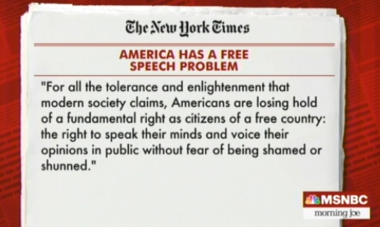
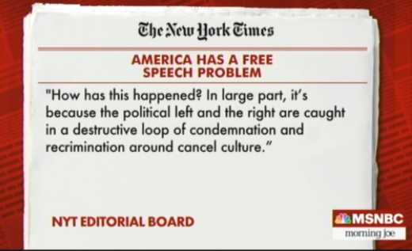
An End to Cancel Culture (2022)?? Conservatives Find Success Canceling and the NYT Calls for an End
In 2021, conservatives found success at K-12 school board meetings around the country, essentially canceling some K-12 teachers who were allegedly teaching that America is systemically racist
In 2022, the NYT called for a truce, once being a strong advocate of canceling offensive free speech but now recognizing a problem with attacking our own 1st Amendment
Notes:
https://www.nytimes.com/2022/03/18/opinion/cancel-culture-free-speech-poll.html (3-18-2022) – The title of this article is, “America has a Free Speech Problem.” This was written by the NYT Editorial Board, who has been a source of cancel culture prior to this statement in March 2022. For instance, in 2020, NYT editor, Bari Weiss resigned, claiming the NYT had an illiberal culture against free thought and speech. You can find her statement here: https://nypost.com/2020/07/14/bari-weiss-on-why-she-left-the-new-york-times/
In 2022, Texas and Florida have passed laws against K-12 teachers teaching Critical Race Theory (CRT). Critical Race Theory (CRT) is not really what the two states have canceled, because CRT is taught in law school, to graduate students pursuing a law degree, but nevertheless, teaching that America is a systemically racist country is common between CRT and whatever K-12 teachers are allegedly teaching in the classroom. The point here is that conservatives have entered the “cancel culture” arena, now canceling liberals, whereas for several year prior, sometime in the 2013-15 timeframe up to 2021, what was happening in America mostly was liberals canceling conservatives. The lesson here is that in order to stop a dangerous (authoritarian) trend, the other side has to fight back and win some victories, which is what conservatives are doing in 2022. It is terrible for conservatives to cancel free speech among liberals (liberals should have the right to say that America is systemically racist and argue that position—and in the arena of free speech—conservatives should have the right to argue the opposite), but an institution like the NYT, one that is on the left of American politics, would never stop canceling conservative free speech as long as they were winning, with no pushback. The NYT has reversed course only because conservatives are enjoying some success in canceling liberals.

Slide 20
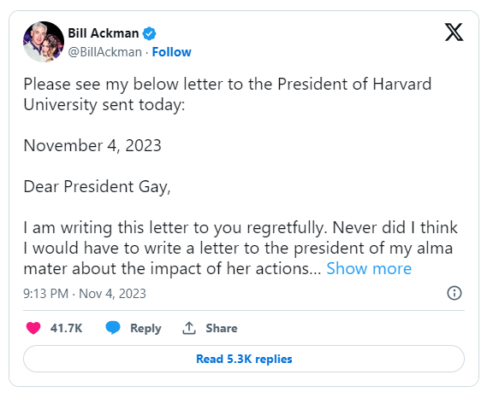
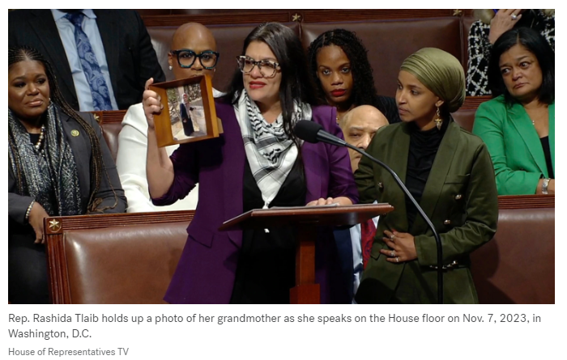
An End to Cancel Culture (2023)?? Pushback Against Pro-Hamas Protesters after Attack on Israel
In Oct-Nov 2023, in the wake of the Hamas attack on Israel (10/7/23), conservatives have “canceled” liberals for their engaging in offensive free speech
Bill Ackman, Wall Street billionaire, Harvard alumnus, called for pro-Hamas student demonstrators at Harvard to be identified so that he and others on Wall Street don’t hire them
The U.S. House censored the only Palestinian-American in Congress, Rashida Tlaib (D-MI)
Notes:
Rhashida Tlaib (D-MI) is censored by the U.S. House for exercising free speech: House censures Rashida Tlaib as she defends comments over Israel: 'Palestinian people are not disposable' (msn.com) https://www.msn.com/en-us/news/politics/house-censures-rashida-tlaib-as-she-defends-comments-over-israel-palestinian-people-are-not-disposable/ar-AA1jz30m?ocid=msedgntp&pc=ACTS&cvid=98759865dce54ba9b6c3c96523d3ab2b&ei=9
Bill Ackman, Wall Street Billionaire and graduate of Harvard, regarding his 3000-word letter to the President of Harvard U., urging her to suspend Harvard students who bully Jewish students: Bill Ackman Is Taking His Crusade Against Antisemitism at Harvard to the Next Level (businessinsider.com) https://www.businessinsider.com/bill-ackman-harvard-president-letter-israel-antisemitism-tweets-2023-11

Slide 21
The Debate in America
Liberal and Conservative Objections to Freedom

Slide 22
Controversial Freedoms Freedoms Many Conservatives would find Objectionable
Burning the American Flag
Flag-burning is disrespectful and offensive to many Americans, especially to many conservatives
The flag is considered to be a symbol of freedom, and an attack on it is viewed by some as an attack on our system of government
The Politics: Flag-burning has been legal in America since 1989
Though for 200 years in America, flag-burning was illegal in America
In 1989, the U.S. Supreme Court ruled that flag burning is a form of “symbolic speech” protected under the 1st Amendment
The Big Picture
Flag burning may be disrespectful and offensive, but in a “purely” free society, in the hierarchy of values, the more important question is not whether it is rightful or wrongful behavior but whether it is a fundamental right
Notes:
Flag Burning: Do we have a fundamental right to burn the flag?
Texas v. Johnson (1989) – Supreme Court struck down a Texas law banning the desecration of the US flag...the Court considers flag burning to be a form of symbolic speech protected by the 1st Amendment
Johnson burned a flag in protest of President Reagan’s policies at the 1984 Republican National Convention in Dallas
Flag Protection Act of 1989 – Congress, Bush41 and the public overwhelmingly opposed the SC decision on flag burning. In response, Congress passed the Flag Protection Act of 1989 banning the desecration of the flag
Is burning the Bible or Qu’ran constitutional? According to some legal experts, the answer is yes, for the same reason flag burning is constitutional. See http://abcnews.go.com/print?id=11602696

Slide 23
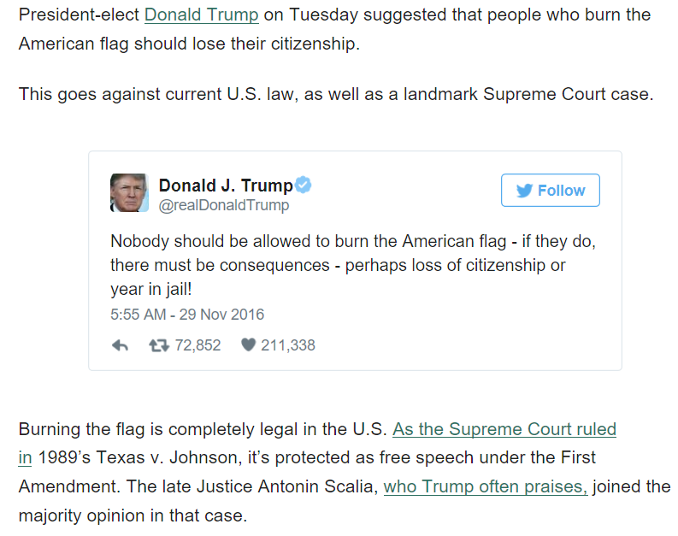
Controversial Freedoms Objections to Flag Burning: President Elect Trump’s Tweet
Despite the US Supreme Court’s decision to legalize flag burning as a form of symbolic free speech, there is strong latent sentiment against flag burning, as expressed by a Donald Trump tweet during the transition
In this case, Trump has taken a more conservative, traditional stand that is intolerant of the right of free speech/expression, even if that speech is offensive
Notes:
Source: 11/29/2016 -- http://www.huffingtonpost.com/entry/donald-trump-flag-burning_us_583d6f88e4b0860d61164f72

Slide 24
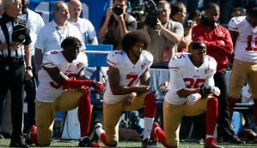
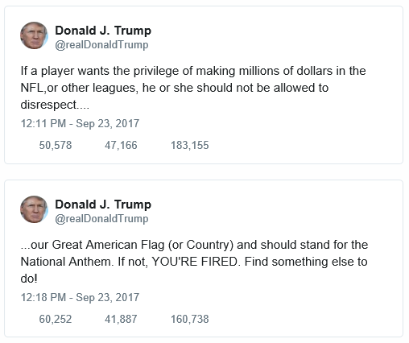
Controversial Freedoms Showing Disrespect to the Flag: NFL Players “Taking a Knee”
Quarterback Colin Kaepernick started the trend in the NFL to kneel during the national anthem at NFL games in protest of police shootings of young black males
In Sept 2017, President Trump took offense at the protests (see tweets)
On the one hand, NFL players have the right to protest (though their contracts may place some restrictions on how they protest) injustices in society. On the other, a free society like ours produces sports leagues where athletes can make big money and fulfill their potential
The American flag can represent either of these realities, or both
“Taking a Knee” is yet another example of displays of free speech/expression that is very offensive to some
After the police killing of George Floyd (May 2020), the NFL changed its policy on kneeling in protest and players are now free to express themselves during the Anthem
Notes:
Colin Kaepernick was the NFL player who kick started the national anthem protests (pictured as No. 7 in the picture on the slide).
http://www.cnn.com/2017/09/24/us/nfl-trump-take-knee-protests/index.html
Here is an except from the link above, explaining why Kaepernick protests the national anthem: “Kaepernick, who has sat and knelt during the anthem, has said he refused to honor a song or "show pride in a flag for a country that oppresses black people and people of color." He also referenced the shootings of black men by police as one of reasons for his stance. "To me, this is bigger than football and it would be selfish on my part to look the other way," he told NFL Media. "There are bodies in the street and people getting paid leave and getting away with murder.“”
Here is an excerpt from the link above, with Trump’s comments: “In Sunday morning tweets, Trump renewed his criticism of the protests, slamming the league's ratings and saying players should be fired or suspended for such protests. On Saturday, he called for NFL owners to fire any "son of a bitch" who "disrespects our flag.“”
In the 2018-19 NFL season, “taking a knee” disappeared from the football field. The NFL league office promised the players that it would spend $90 million to promote social justice projects throughout the country, as well as sponsor NFL players as they engage in political activism. This was sufficient to turn the protests on the field into activism in the various communities of America.
The NFL league office and NFL owners were worried that “taking a knee” protests during the national anthem would turn away viewers and fans of the game, thus taking away from NFL profits (from ad revenue on TV and ticket and merchandise sales). Ultimately, the NFL is a business, and team owners did not want to poison the entertainment and “escape” the game provides to fans with politics on the field of play. This policy abruptly changed with the police killing of George Floyd (May 2020). The NFL Commissioner posted a video in support of Black Lives Matter, and the NFL announced that players would be able to kneel during the national anthem.

Slide 25
Controversial Freedoms Freedoms Many Religious Conservatives would find Objectionable
Burning the Bible or the Qu’ran
Burning a religious text is very disrespectful and offensive to Christians (Bible) and Muslims (Qu’ran)
The U.S. Supreme Court has not ruled on a case involving the burning of religious texts, but some legal scholars believe this too would be a form of symbolic free speech
Offensive Behavior to some Muslims
In 2005, a Danish newspaper published cartoons of the Prophet Muhammad, which resulted in protests in Denmark and violence and property damage against Danish embassies in some other countries
In 2020, a school teacher in France was be-headed on a public street for displaying the cartoons first published in 2005, as a lesson in free speech
In the U.S., for several years, an anti-Muslim pastor named Terry Jones burned Qu’rans on the anniversary of 9/11
In 2010, Terry Jones stood down at the request of the Sec. of Defense (Robert Gates), who worried that burning Qu’rans would spark violence against U.S. troops in Afghanistan
Notes:
Historically, conservatives have objected to offensive free speech, believing that “in your face” gestures are bad manners, and also historically, liberals have been the defenders of offensive displays of expression and free speech (e.g., communist beliefs, protesting war, burning the American flag, etc.). But in more recent decades, liberals have become more hostile to offensive free speech, and now conservatives are starting to defend these types of displays, particularly when they are aimed at Muslims (e.g., making fun of the Prophet Mohammad) or against or about black people (e.g., the use of the n-word).
See this youtube 11-minute video to view and hear a protest rally in Britain, held in protest of the publication of the Mohammad cartoons in the Danish newspaper, as well as protests against the USA and George Bush (the U.S. president at the time): https://www.youtube.com/watch?v=B_kyNIevsIs
To see a 46-minute documentary on the publication of the Mohammad cartoons in the Danish news paper: https://www.youtube.com/watch?v=cTiJxRI9AJE
Beheading in France (Oct 2020)
https://www.msn.com/en-us/news/world/chechen-leader-macron-s-stance-on-muhammad-cartoons-forcing-people-into-terrorism/ar-BB1arWdp?ocid=msedgntp
https://www.realclearpolitics.com/articles/2020/11/01/standing_with_france_and_free_speech_after_terror_attack.html

Slide 26
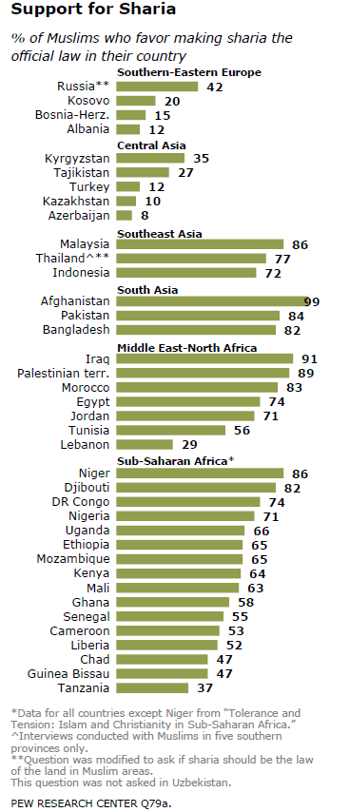
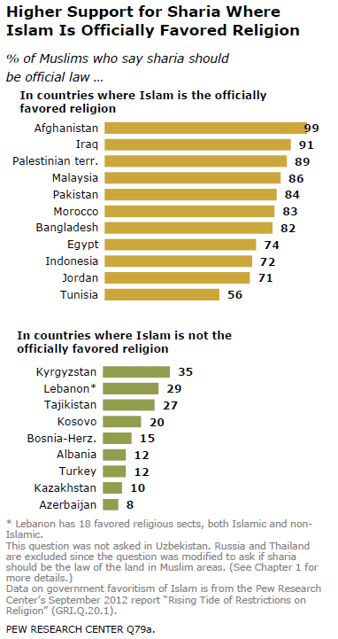
Controversial Freedoms Where Muslims Stand on Combining Religion and Government (2014)
Strong support for Sharia Law is an endorsement of a more religious government (theocracy)
Notice how people typically conform to the beliefs of the dominant culture: Sharia is favored much more strongly when Islam is the dominant religion and when society is non-secular (more religious)
Notes:
Source: Pew Research Center, “The World’s Muslims: Religion, Politics and Society,” published on April 30, 2014. Data was collected in 39 countries between 2008 and 2012.
Cut and pasted from the Pew Research Center Report: “Within regions, support for enshrining sharia as official law is particularly high in some countries with predominantly Muslim populations, such as Afghanistan and Iraq. But support for sharia is not limited to countries where Muslims make up a majority of the population. In sub-Saharan Africa, for example, Muslims constitute less than a fifth of the population in Cameroon, the Democratic Republic of the Congo, Ghana, Kenya, Liberia, Mozambique and Uganda; yet in each of these countries, at least half of Muslims (52%-74%) say they want sharia to be the official law of the land.”
“Conversely, in some countries where Muslims make up more than 90% of the population, relatively few want their government to codify Islamic law; this is the case in Tajikistan (27%), Turkey (12%) and Azerbaijan (8%).”
Here’s how the report explains/defines “Sharia”: “Sharia, or Islamic law, offers moral and legal guidance for nearly all aspects of life – from marriage and divorce, to inheritance and contracts, to criminal punishments. Sharia, in its broadest definition, refers to the ethical principles set down in Islam’s holy book (the Quran) and examples of actions by the Prophet Muhammad (sunna). The Islamic jurisprudence that comes out of the human exercise of codifying and interpreting these principles is known as fiqh. Muslim scholars and jurists continue to debate the boundary between sharia and fiqh as well as other aspects of Islamic law.”

Slide 27
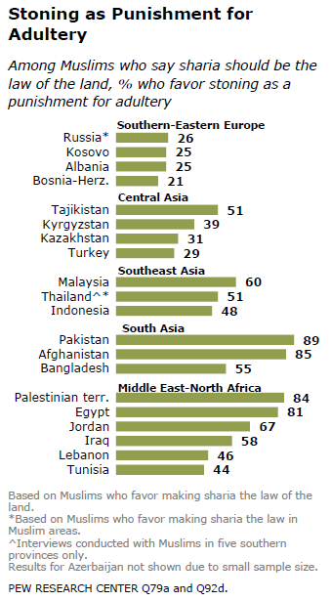
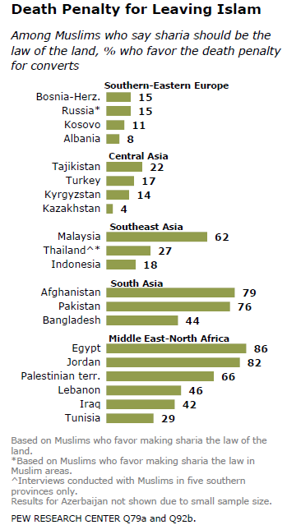
Controversial Freedoms Where Muslims Stand on Combining Religion and Government (2014)
Adultery, however immoral, is not punished in a “free” society
Freedom of conscience (the right to believe as one wishes), which would include switching religions from Islam to another, is not punished in a “free” society
Notes:
Source: Pew Research Center, “The World’s Muslims: Religion, Politics and Society,” published on April 30, 2014. Data was collected in 39 countries between 2008 and 2012.

Slide 28
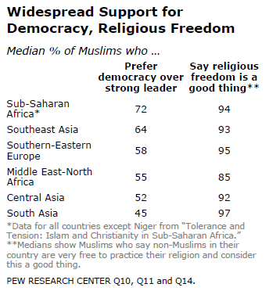
Controversial Freedoms Where Muslims Stand on Combining Religion and Government (2014)
Despite holding some illiberal (authoritarian) views in some countries, strong majorities of Muslims almost everywhere prefer democracy and religious freedom
It is important to note that people holding contradictory viewpoints is the norm—it’s true of Muslims in the polls presented in this lecture, and it is true for people of all faiths and ideologies, everywhere
Notes:
Source: Pew Research Center, “The World’s Muslims: Religion, Politics and Society,” published on April 30, 2014. Data was collected in 39 countries between 2008 and 2012.

Slide 29
Controversial Freedoms Freedoms Many Conservatives would find Objectionable
Recreational Marijuana Use
Recreational marijuana use is considered “immoral” by many conservatives because it is unhealthy in most cases
Though it has medicinal benefits, most people use marijuana to relax, and in these cases, people aren’t doing anything productive (though relaxation is healthy for one’s psyche and stress level)
Conservatives tend to be against marijuana use because it is used to get “high” (in most cases), which tends to encourage people to be lazy
The Politics: 19 states have legalized marijuana use for recreational purposes, Colorado being among the first and most prominent
The trend in America is toward legalizing marijuana; polls show majority support for legalizing it for recreational use, as well as showing that a majority view marijuana use as less harmful than alcohol
The Big Picture
Marijuana use may be unhealthy and thus immoral, but in a “purely” free society, in the hierarchy of values, the more important question is not whether it is rightful or wrongful behavior but whether it is a fundamental right
Notes:
See pollingreport.com for a repository of polls on the public’s views on marijuana (and many other political issues).

Slide 30
Controversial Freedoms Freedoms Many Conservatives would find Objectionable
Same-Sex (Gay) Marriage/Relations
Same-sex (gay) marriage/relations are considered to be irreligious behavior by many religious conservatives
The Bible condemns homosexuality:
Leviticus 18:22 -- Do not have sexual relations with a man as one does with a woman; that is detestable.
Leviticus 20:13 -- If a man has sexual relations with a man as one does with a woman, both of them have done what is detestable. They are to be put to death; their blood will be on their own heads.
These are versus from the Old Testament; Christians tend to reject the harsh punishments of the Old Testament given Jesus’s behavior, as told in the parables of the New Testament
The Politics: 37 states had legalized same-sex marriage prior to the U.S. Supreme Court’s decision to legalize it in all states
Prior to the Court’s decision (2015), the trend in America was toward legalizing same-sex marriage; a majority of the public began to support same-sex marriage in 2012-13 timeframe, and about 31 states legalized it after the turn in public opinion
The Big Picture
Same-sex marriage/relations may be irreligious, but in a “purely” free society, in the hierarchy of values, the more important question is not whether it is rightful or wrongful behavior but whether it is a fundamental right
Notes:
See pollingreport.com for a repository of polls on the public’s views on same-sex marriage (and many other political issues).
The Bible addresses homosexuality. In the Old Testament, homosexuality is considered a sexually deviant behavior along with about 20 others, such as bestiality, incest and adultery. All of these behaviors carry harsh punishments, usually death. The punishment for homosexuality is death by stoning (see Leviticus 18:22; 20:13). There are critics who challenge the meaning of these verses in the Bible, such as the Biblical meaning of an “abomination” (see http://www.soulforce.org/article/homosexuality-bible-gay-christian), and others point out that many behaviors that we accept today are also harshly condemned in the Bible, sometimes prescribing the penalty of death. For instance, cursing one’s parents is punishable by death (see Leviticus 20:9); adultery is punishable by death (see Leviticus 20:10 & Deuteronomy 22:22); if a man suspects that his wife was not a virgin at the time of consummation, and it turns out true that she was not a virgin, then she is to be stoned to death (see Deuteronomy 22:13-21); if a man has sex with a woman during her flow (“time of the month”), both the man and woman are to be cut off from their people (see Leviticus 18:19); if a man is recently married, he is not to be sent off to war or have any other duty assigned to him—rather, for one year, he is free to stay at home with his wife and bring happiness to her (see Deuteronomy 24:5). Cursing one’s parents, adultery, and having sex while a woman is having her period, a bride who is not a virgin, sending a newlywed off to war—all are tolerable behaviors by individuals or by government (in the case of sending a man off to war) today that don’t carry any punishments. The point here is that gay rights advocates are perturbed that homosexuality is being singled out as immoral behavior, while these other behaviors are tolerated today.
Many Christians argue that Christianity rejects the harsh punishments of the Old Testament. As mentioned previously, the Old Testament prescribes death for cursing one’s parents (see Leviticus 20:9), for committing adultery (see Leviticus 20:10 & Deuteronomy 22:22), for a woman who turns out not to be a virgin at marriage (see Deuteronomy 22:13-21), and for homosexuality (see Leviticus 18:22; 20:13). Jesus does not explicitly reject these punishments in the New Testament; in fact he says his purpose is to confirm the law, perhaps implying that he accepts the prescriptions for punishment in the Old Testament (or perhaps Jesus is just affirming the 10 Commandments), but Jesus’ message is certainly not “kill, kill, kill,” as it is in some parts of the Old Testament. And given that Jesus does not stress punishment in the New Testament, one might plausibly conclude that he rejects the harsh punishments of the Old Testament. More explicit evidence that Jesus rejects the harsh punishments of the Old Testament is exemplified in a story in which Jewish leaders bring an adulteress (allegedly caught in the act) to Jesus. Jesus tries to ignore their incessant demands that he address whether or not the woman should be stoned to death. Eventually, he addresses the gathering, insisting that whoever among them was without sin should throw the first stone at the woman. One by one, the woman’s accusers left out of guilt (presumably because they too were sinners), and Jesus told the woman that he would not condemn her and that she was free to go. He did implore that she not sin again, though. Still, in this case, Jesus did not want this woman killed, which implies that he rejects the Old Testament prescription for adulterers to be put to death. Also, Paul addresses adultery in the nascent Christian communities he visits. Paul is appalled by the number of men he finds cheating on their wives (i.e., committing adultery) with prostitutes. He tries to discourage men from sleeping with prostitutes by arguing that they don’t own their bodies, that they are not only defiling themselves with prostitutes but also Jesus, since their bodies are part of Christ (see 1 Corinthians 6:15). No where does Paul mention that the punishment for adultery is death, so one may also plausibly argue that Christians reject these harsh punishments given how Paul addresses adultery.

Slide 31
Controversial Freedoms Freedoms Many Liberals would find Objectionable
Gun Ownership
Gun ownership is considered “potentially dangerous” by many liberals because there are so many irresponsible people who own guns
Many liberals worry that our gun culture results in so much more violence, believing that “gun control” is necessary to reduce violent crime in America
Many liberals also picture a “redneck” racist country hick with a gun—and they find that image to be horrifying
The Politics: All 50 states have legalized concealed handgun licenses; about half the states have “stand your ground” laws
The trend in America is toward securing more gun-owners’ rights; the effort by civil rights leaders (namely, Al Sharpton) to repeal “stand your ground” laws is likely to fail because the gun rights lobby, as well as our gun culture, is so strong in American politics
The Big Picture
Gun ownership may be “potentially dangerous,” but in a “purely” free society, in the hierarchy of values, the more important question is not whether it is right or wrong for one to own a gun but whether one has a fundamental right to own a gun
Notes:
Liberals would also cite the Las Vegas shooting as a prime example of why the prevalence of guns is so dangerous. The Las Vegas shooter had more than a dozen guns that he brought to his hotel room. Buying dozens of guns is legal and does not raise suspicion among law enforcement agencies. Liberals would argue that purchases of large numbers of guns should be monitored by law enforcement authorities.
See pollingreport.com for a repository of polls on the public’s views on guns (and many other political issues).

Slide 32
Controversial Freedoms Freedoms Many Liberals would find Objectionable
Corporate Profits (The Wealthy)
Corporate profits are considered by many liberals to be “excessive” because they view wealthy corporations as not paying their fair share in taxes
Many liberals object to the inequality in wealth and income in a majority capitalist economy, and they want the wealthy, including corporations, to pay more in taxes
The Politics: Corporations quietly buy influence in our political system by forming interest groups that lobby elected officials
There is a slow (shallow) trend toward more government control of the economy in America, but wealthy corporations have political power, and some of them have found ways to reduce their tax burdens (such as by “officially” transferring their “headquarters” to Ireland or Switzerland)
The Big Picture
Corporate profits may be “excessive,” but in a “purely” free society, in the hierarchy of values, the more important question is not whether corporations make too much money but whether corporations have the right to maximize their profits in a majority-capitalist economy
Notes:
This is not an example of a corporation, just a very wealthy individual. In May 2015, there was a professional boxing match between two of the most successful boxers in the modern era, Floyd Mayweather and Manny Pacquaio. Mayweather earned around $200 million for the fight. Liberals would typically argue that Mayweather doesn’t need $200 million to live a good life and provide for his 4 children and his many girlfriends. Liberals would argue that Mayweather’s earnings is a gross example of inequality in wealth and income and that a large portion of the money should be taxed to pay for roads, schools, and health care for the poor and needy. In contrast, conservatives would argue that Mayweather earned the money. His reputation as a great boxer attracted so many more viewers to purchase access to the fight via pay-per-view, which cost $100.00. Conservatives would argue that Mayweather didn’t steal anything, that he didn’t force people to pay $100 to see the fight, and that he earned his % of the pay-per-view revenue…and that he should be able to keep what he earned.
There is an interesting trend occurring among “populist” conservatives (Trump is a populist conservative). This branch of conservatism is starting to become anti-corporation, similar to the orientation of traditional liberals. What has converted populist authoritarians is the moves by “big tech” (Facebook, Twitter, Google, etc.) to “flag” conservative opinions as “misinformation.” Now, populists are viewing wealthy and powerful corporations, e.g., big tech firms, as a threat to the non-conforming little guy who holds controversial views and who wants to communicate those views on the modern-day platforms of communication, e.g., Facebook, Twitter, etc.

Slide 33
Controversial Freedoms Freedoms Many Liberals would find Objectionable
Discrimination in the Business World
Discrimination in business is considered by many liberals to be “racist” or wrongful discrimination of some other form
Because of our racist history of slavery, segregation, and discrimination against blacks, our laws don’t tolerate businesses who discriminate
Voting Rights Act (1965): Banned a business from discriminating against blacks
At the time, many businesses, particularly in the South, would only serve whites
Current federal law protects the following categories of demographics from workplace discrimination: race, gender, religion, national origin, color, age, disability, genetic information
The Politics: Today, the demographic fighting for rights against discrimination in business are gays/lesbians and transgendered people
The trend in the country is toward protecting gays/lesbians as some cities (not Houston) and states have begun to pass civil rights protections, and the U.S. Supreme Court ruled (2020) that businesses could not discriminate in hiring/firing employees based on sexual orientation or for being transgendered
The Big Picture
Business discrimination in hiring/firing or serving may be “racist” or “wrong” in some other way, but in a “purely” free society, in the hierarchy of values, the more important question is whether a business has a right to discriminate
Notes:
Given our civil rights laws, the answer to the question, “does a business have a right to discriminate?” The answer is no. But in a purely free society, the answer would be yes.
If America embraced a right to discriminate in the workplace, then in a “purely” free and capitalist economy, the means of combating wrongful discrimination would be through protests and boycotts of businesses. Cancel culture is using condemnation and boycotts to exert pressure today, and it is working. BLM is doing the same. After George Floyd was killed (May 2020), many businesses started to remove their racist imagery from their products and names.
https://www.discovery.org/econ/2020/07/09/cult-programming-in-seattle/ -- Whites were singled out for racial training in Seattle. This goes against the civil rights tradition in our country. We cannot single out one race, but it is happening today. Essentially, this is what it was like for blacks before there were civil rights laws. Blacks weren’t welcome in white businesses and in white communities, because of racist sentiments, so blacks started their own businesses in their own communities, and this was the reality of America for decades. Then, when civil rights laws were passed, we essentially said to whites that you have to accept blacks in your businesses.
Now, we have reverted back to a pre-civil rights era, where whites are being singled out for being white (usually by other whites) within businesses. So now, businesses have the flexibility to set their own policies, even if they are discriminatory against whites, such as singling out whites for racial training. This is sort of a “what comes around, goes around policy.” Once upon a time in America, whites made blacks uncomfortable for being black, and now whites are being made to feel uncomfortable (mostly by other whites) for being white.
We have abandoned the MLK Jr. goal of judging each other by the contents of our character rather than by the color of our skin, because now whites are under attack for being white. Whites are perceived as being inherently privileged and thus are being forced to atone for this perceived reality. This is a rejection of principle of equality under the law and of the principles of equality that MLK Jr. envisioned…and no one is saying a word about it. We are sprinting toward a society of anything goes, a governing system of unconstrained power. Power will not be constrained by the principles of right v. wrong, nor constrained by the principles of freedom, nor by the principles of democracy. This is the mindset we are headed toward: “Your ancestors did it to my ancestors, now I’m going to do it to you.”

Slide 34
Controversial Freedoms Freedoms Many Liberals would find Objectionable
Offensive Free Speech
Historically, it has been conservatives who have objected to offensive displays (e.g., burning the American flag), but increasingly, it is liberals who are now openly hostile to offensive free speech
Liberals tend to be intolerant of offensive comments directed at Muslims (e.g., making fun of the Prophet Mohammad) or at black people (e.g., the n-word) or at gay/lesbian or transgendered people or offensive remarks considered to be (micro) aggressions
Racist/racially sensitive remarks or other offensive comments are punished in our culture today (not usually by government, though)…increasingly, this is also true of comments directed at gays/lesbians and trans people
Our culture (i.e., private businesses) increasingly advocates for firing people who engage in offensive free speech…laws and policies of government often follow cultural norms, though as of today, the government does not typically punish offensive free speech
The Politics: Few elected leaders can politically survive a charge of being “racist,” and we are in an era now where anything in politics or culture that is perceived as “racist” or “offensive” in other ways is not being tolerated
The Big Picture
Verbal attacks may be offensive and wrong in some contexts, but in a “purely” free society, in the hierarchy of values, the more important question is whether or not people have a right to engage in offensive free speech
Notes:
If America embraced a right to discriminate in the workplace, then in a “purely” free and capitalist economy, the means of combating wrongful discrimination would be through protests and boycotts of businesses.
We see economic boycotts today typically directed at those who are trying to protect offensive free speech, such as Facebook. In 2020, a movement called “stop hate for profit” is pressuring Facebook to takedown the speech of white supremacists and Holocaust deniers, which it considers to be “hate speech,” and 400+ advertisers on Facebook have (temporarily) pulled their ads, causing Facebook’s stock value to fall and resulting in a huge loss of revenue for Facebook. White supremacy and Holocaust denial is definitely “hate speech,” but non-violent forms of hate speech are constitutional under the 1st Amendment. What we are witnessing is the power of “cancel culture” on display in America. Facebook is a private company which can set any rules it wants. If it wants, it could take down speech that reflects white supremacy and Holocaust denial, and that would be consistent with capitalism (in this context, capitalism being the right of a business to set its own rules), but it would not be consistent with our democratic values under the 1st Amendment, which posits that even the most offensive speech must be protected if ultimately we are to protect “more reasonable” free speech, because it is a slippery slope. If you give the authoritarians of “cancel culture” an inch, they will push as far as they can. Their ultimate goal is authoritarianism of some form (Marxism, communism, fascism, or something similar), under which the proper form of “hate speech” would be completely acceptable, that which is directed at their political enemies.
In a purely free society, which holds free speech as its highest value, the “punishment” for individuals who engage in offensive free speech would be social condemnation (i.e., using one’s free speech rights against those who engage in offensive speech), which may or may not silence the offender. That’s what is so dissatisfying about that standard in our society today. “Cancel culture” demands that people who are offensive be silenced (i.e., shut them up), and in many cases, social condemnation alone is not enough to silence people. For instance, if we fight white supremacy and Holocaust deniers with reason, or more reasonable speech, most likely, that will not shut them up. One cannot reason with authoritarians who only want power and then to assert that power in the most unjust ways (which would be true of white supremacists on the right and of the advocates of “cancel culture” on the left). So, our culture demands a harsher punishment than social condemnation. Yet, silencing people goes against the values of a “purely” free society, which holds free speech as its highest value.
When a dictator takes over in a country, priority one is to take over all media outlets and to crack down on protests and other forms of free expression. These actions signal that which dictators find most threatening, which would be criticism of any form, and their first priority is to silence their opposition. We are seeing a form of “silencing” in America today. “Cancel culture” rejects the notion of offensive free speech, or anything that is regarded as unpopular speech. The 1st Amendment is listed first because it is the most important check against the rise of a dictatorship, and “cancel culture” is frantically chipping away at the 1st Amendment. The courts have not followed the prescriptions of “cancel culture” to date, but our elected officials and judges will follow the public will at some point, presuming this “silencing” trend continues. Our culture today fully embraces a very dangerous and crucially important component of a dictatorship, which is to silence unpopular speech (and ideas).
Democratic values are imperiled, not just in America, but worldwide as well. We live in an era where authoritarian values are on the rise, and in America, this form of authoritarianism is most accurately reflected by “cancel culture.”
----------------------------

Slide 35
Conclusions
Controversial freedoms are:
Offensive
Immoral
Irreligious
Potentially dangerous
Excessive
Discriminatory, racist, or aggressive
Here is how freedom is supposed to be viewed:
In the hierarchy of values, freedom (“individual rights”) comes first; people’s sensitivities toward mores, religion, or their political values (inequality in wealth, discrimination, etc.) come second
In world politics, the issue is this:
For 15 centuries the “Western” (free) world has struggled against (authoritarian) monarchy and Christianity (when religion shares power in government) for freedoms that were once considered unacceptable
In the 20th Century, the “Western” (free) world struggled against fascism and communism
Today, the struggle is between freedom and theocracy (when Islam shares power in government) in the world and between freedom and “cancel culture” at home
Notes:
Here is a list of terrorist attacks between 2011 and 2017: http://www.foxnews.com/world/2017/11/01/timeline-recent-terror-attacks-against-west.html
https://www.bariweiss.com/resignation-letter – Bari Weiss resigned as editor of the NYT because she was bullied in an “illiberal environment.” This is another example of “cancel culture.” Weiss is a liberal but not far-left enough for the NYT.
Here is a letter, published in Harper’s Magazine on July 7, 2020, signed by 150 people who share a liberal viewpoint, including J.K. Rowlings (Harry Potter author). The piece acknowledges that “cancel culture” is a phenomenon of the left, as it considers Donald Trump to be a threat to democracy and in alliance with “cancel culture,” despite Trump’s Independence Day speeches at Mount Rushmore and in Washington DC, where he identified “cancel culture” as left-wing fascists.
https://harpers.org/a-letter-on-justice-and-open-debate/
A Letter on Justice and Open Debate
July 7, 2020 The below letter will be appearing in the Letters section of the magazine’s October issue. We welcome responses at letters@harpers.org
Our cultural institutions are facing a moment of trial. Powerful protests for racial and social justice are leading to overdue demands for police reform, along with wider calls for greater equality and inclusion across our society, not least in higher education, journalism, philanthropy, and the arts. But this needed reckoning has also intensified a new set of moral attitudes and political commitments that tend to weaken our norms of open debate and toleration of differences in favor of ideological conformity. As we applaud the first development, we also raise our voices against the second. The forces of illiberalism are gaining strength throughout the world and have a powerful ally in Donald Trump, who represents a real threat to democracy. But resistance must not be allowed to harden into its own brand of dogma or coercion—which right-wing demagogues are already exploiting. The democratic inclusion we want can be achieved only if we speak out against the intolerant climate that has set in on all sides.
The free exchange of information and ideas, the lifeblood of a liberal society, is daily becoming more constricted. While we have come to expect this on the radical right, censoriousness is also spreading more widely in our culture: an intolerance of opposing views, a vogue for public shaming and ostracism, and the tendency to dissolve complex policy issues in a blinding moral certainty. We uphold the value of robust and even caustic counter-speech from all quarters. But it is now all too common to hear calls for swift and severe retribution in response to perceived transgressions of speech and thought. More troubling still, institutional leaders, in a spirit of panicked damage control, are delivering hasty and disproportionate punishments instead of considered reforms. Editors are fired for running controversial pieces; books are withdrawn for alleged inauthenticity; journalists are barred from writing on certain topics; professors are investigated for quoting works of literature in class; a researcher is fired for circulating a peer-reviewed academic study; and the heads of organizations are ousted for what are sometimes just clumsy mistakes. Whatever the arguments around each particular incident, the result has been to steadily narrow the boundaries of what can be said without the threat of reprisal. We are already paying the price in greater risk aversion among writers, artists, and journalists who fear for their livelihoods if they depart from the consensus, or even lack sufficient zeal in agreement.
This stifling atmosphere will ultimately harm the most vital causes of our time. The restriction of debate, whether by a repressive government or an intolerant society, invariably hurts those who lack power and makes everyone less capable of democratic participation. The way to defeat bad ideas is by exposure, argument, and persuasion, not by trying to silence or wish them away. We refuse any false choice between justice and freedom, which cannot exist without each other. As writers we need a culture that leaves us room for experimentation, risk taking, and even mistakes. We need to preserve the possibility of good-faith disagreement without dire professional consequences. If we won’t defend the very thing on which our work depends, we shouldn’t expect the public or the state to defend it for us.
Elliot Ackerman Saladin Ambar, Rutgers University Martin Amis Anne Applebaum Marie Arana, author Margaret Atwood John Banville Mia Bay, historian Louis Begley, writer Roger Berkowitz, Bard College Paul Berman, writer Sheri Berman, Barnard College Reginald Dwayne Betts, poet Neil Blair, agent David W. Blight, Yale University Jennifer Finney Boylan, author David Bromwich David Brooks, columnist Ian Buruma, Bard College Lea Carpenter Noam Chomsky, MIT (emeritus) Nicholas A. Christakis, Yale University Roger Cohen, writer Ambassador Frances D. Cook, ret. Drucilla Cornell, Founder, uBuntu Project Kamel Daoud Meghan Daum, writer Gerald Early, Washington University-St. Louis Jeffrey Eugenides, writer Dexter Filkins Federico Finchelstein, The New School Caitlin Flanagan Richard T. Ford, Stanford Law School Kmele Foster David Frum, journalist Francis Fukuyama, Stanford University Atul Gawande, Harvard University Todd Gitlin, Columbia University Kim Ghattas Malcolm Gladwell Michelle Goldberg, columnist Rebecca Goldstein, writer Anthony Grafton, Princeton University David Greenberg, Rutgers University Linda Greenhouse Rinne B. Groff, playwright Sarah Haider, activist Jonathan Haidt, NYU-Stern Roya Hakakian, writer Shadi Hamid, Brookings Institution Jeet Heer, The Nation Katie Herzog, podcast host Susannah Heschel, Dartmouth College Adam Hochschild, author Arlie Russell Hochschild, author Eva Hoffman, writer Coleman Hughes, writer/Manhattan Institute Hussein Ibish, Arab Gulf States Institute Michael Ignatieff Zaid Jilani, journalist Bill T. Jones, New York Live Arts Wendy Kaminer, writer Matthew Karp, Princeton University Garry Kasparov, Renew Democracy Initiative Daniel Kehlmann, writer Randall Kennedy Khaled Khalifa, writer Parag Khanna, author Laura Kipnis, Northwestern University Frances Kissling, Center for Health, Ethics, Social Policy Enrique Krauze, historian Anthony Kronman, Yale University Joy Ladin, Yeshiva University Nicholas Lemann, Columbia University Mark Lilla, Columbia University Susie Linfield, New York University Damon Linker, writer Dahlia Lithwick, Slate Steven Lukes, New York University John R. MacArthur, publisher, writer Susan Madrak, writer Phoebe Maltz Bovy, writer Greil Marcus Wynton Marsalis, Jazz at Lincoln Center Kati Marton, author Debra Mashek, scholar Deirdre McCloskey, University of Illinois at Chicago John McWhorter, Columbia University Uday Mehta, City University of New York Andrew Moravcsik, Princeton University Yascha Mounk, Persuasion Samuel Moyn, Yale University Meera Nanda, writer and teacher Cary Nelson, University of Illinois at Urbana-Champaign Olivia Nuzzi, New York Magazine Mark Oppenheimer, Yale University Dael Orlandersmith, writer/performer George Packer Nell Irvin Painter, Princeton University (emerita) Greg Pardlo, Rutgers University – Camden Orlando Patterson, Harvard University Steven Pinker, Harvard University Letty Cottin Pogrebin Katha Pollitt, writer Claire Bond Potter, The New School Taufiq Rahim, New America Foundation Zia Haider Rahman, writer Jennifer Ratner-Rosenhagen, University of Wisconsin Jonathan Rauch, Brookings Institution/The Atlantic Neil Roberts, political theorist Melvin Rogers, Brown University Kat Rosenfield, writer Loretta J. Ross, Smith College J.K. Rowling Salman Rushdie, New York University Karim Sadjadpour, Carnegie Endowment Daryl Michael Scott, Howard University Diana Senechal, teacher and writer Jennifer Senior, columnist Judith Shulevitz, writer Jesse Singal, journalist Anne-Marie Slaughter Andrew Solomon, writer Deborah Solomon, critic and biographer Allison Stanger, Middlebury College Paul Starr, American Prospect/Princeton University Wendell Steavenson, writer Gloria Steinem, writer and activist Nadine Strossen, New York Law School Ronald S. Sullivan Jr., Harvard Law School Kian Tajbakhsh, Columbia University Zephyr Teachout, Fordham University Cynthia Tucker, University of South Alabama Adaner Usmani, Harvard University Chloe Valdary Lucía Martínez Valdivia, Reed College Helen Vendler, Harvard University Judy B. Walzer Michael Walzer Eric K. Washington, historian Caroline Weber, historian Randi Weingarten, American Federation of Teachers Bari Weiss Sean Wilentz, Princeton University Garry Wills Thomas Chatterton Williams, writer Robert F. Worth, journalist and author Molly Worthen, University of North Carolina at Chapel Hill Matthew Yglesias Emily Yoffe, journalist Cathy Young, journalist Fareed Zakaria Institutions are listed for identification purposes only.

